Slide 1



Prepared for: Thesis Defense Committee Department of Computer Science and Engineering
IUBAT–INTERNATIONAL UNIVERSITY OF BUSINESS AGRICULTURE AND TECHNOLOGY
Founded 1991 by Md. Alimullah Miyan
Place Thesis Title Here
Course Code: Thesis CSC 488
Supervised by:
Faculty Name: Snaholata Mondal
Designation: Lecturer
Prepared by:
Student1_Name: Md. Abdullah Ibne Aziz ID: 22203246
Student1_Name: Shahriar Ahmed ID: 22203202
Date: 20/02/2026

Slide 2
Contents
Introduction
Literature Review
Methodology
Result and Discussion
Conclusion
References
2

Slide 3
Introduction
Major Depressive Disorder (MDD) is one of the leading causes of disability worldwide.
University students are particularly vulnerable due to:
Academic pressure
Financial stress
Psychosocial challenges
In Bangladesh, mental health services are limited, and social stigma often causes delayed diagnosis and treatment.
Meanwhile, emerging technologies such as Machine Learning (ML), Natural Language Processing (NLP), and digital behavioral data analysis are improving mental health assessment and early detection.
A Comparative Study of Mental Health Detection Using PHQ-9 and Social Media Analysis with Traditional ML and NLP Techniques
3

Slide 4
Introduction (Contd.)
Clinical Foundation – PHQ-9
The Patient Health Questionnaire-9 (PHQ-9) is a validated 9-item depression screening tool.
Based on DSM diagnostic criteria.
Widely used in clinical and epidemiological settings.
Measures emotional, cognitive, somatic, and risk-related symptoms.
A Comparative Study of Mental Health Detection Using PHQ-9 and Social Media Analysis with Traditional ML and NLP Techniques
4

Slide 5
Introduction (Contd.)
Unstructured Linguistic Monitoring
Individuals naturally express emotional distress through language.
Social media enables:
Passive monitoring
Continuous data collection
Real-world emotional expression
A Comparative Study of Mental Health Detection Using PHQ-9 and Social Media Analysis with Traditional ML and NLP Techniques
5

Slide 6
Motivation of the Study
PHQ-9 is clinically validated but depends on self-reporting and periodic administration, limiting continuous monitoring.
Social media language reflects spontaneous emotional and cognitive distress signals.
Existing research typically studies PHQ-9-based ML and NLP-based depression detection separately.
Very limited work exists on Bengali-language depression detection using advanced NLP models.
Lack of a unified comparative framework evaluating structured and unstructured approaches under the same experimental setting.
Motivation to develop a dual-modality framework combining clinical screening and passive linguistic monitoring.
A Comparative Study of Mental Health Detection Using PHQ-9 and Social Media Analysis with Traditional ML and NLP Techniques
6

Slide 7
Research Objectives
Develop traditional ML models using PHQ-9 data.
Develop NLP models using Bengali social media text.
Evaluate both approaches using standardized performance metrics
Apply Explainable AI techniques (SHAP, LIME).
Propose an integrated dual-modality depression screening framework.
A Comparative Study of Mental Health Detection Using PHQ-9 and Social Media Analysis with Traditional ML and NLP Techniques
7

Slide 8
Research Objectives
Construct and optimize traditional machine learning models for depression detection using structured PHQ-9 data.
Design and evaluate NLP-based models for detecting depressive expressions in Bengali social media text.
Conduct a direct performance comparison between structured (PHQ-9) and unstructured (text-based) approaches under a unified evaluation framework.
Assess model robustness using cross-validation and standardized metrics
Enhance clinical transparency through Explainable AI techniques such as SHAP and LIME.
Investigate the feasibility of an integrated dual-modality screening framework combining clinical and linguistic signals.
A Comparative Study of Mental Health Detection Using PHQ-9 and Social Media Analysis with Traditional ML and NLP Techniques
8

Slide 9
Research Questions
How do PHQ-9-based ML models compare with Bengali text-based NLP models for depression detection?
Can linguistic features match the predictive performance of PHQ-9 screening?
How robust and generalizable are the models under cross-validation and standard metrics?
How much do XAI methods improve interpretability and transparency?
Is a combined PHQ-9 + NLP framework feasible for scalable depression screening?
A Comparative Study of Mental Health Detection Using PHQ-9 and Social Media Analysis with Traditional ML and NLP Techniques
9

Slide 10
Literature Review
Paper: Dey et al. (2022) – Machine Learning Combined with PHQ-9 for Analyzing Depression in Bangladeshi Metropolitan Areas
Key Findings
Applied machine learning models on PHQ-9 responses collected from Bangladeshi participants.
Demonstrated that ML can improve depression classification beyond manual scoring.
Showed practical feasibility of ML-based screening in local population context.
Limitations
Limited exploration of advanced ensemble boosting models.
No probability calibration for clinical risk estimation.
Did not compare PHQ-9-based ML with NLP-based approaches.
A Comparative Study of Mental Health Detection Using PHQ-9 and Social Media Analysis with Traditional ML and NLP Techniques
10

Slide 11
Literature Review
Paper: Haq et al. (2022) – Comparison of ML Algorithms for Predicting Depression Among University Students in Bangladesh
Key Findings
Applied Random Forest and SVM on PHQ-9 data.
Demonstrated ML feasibility in Bangladeshi student population.
Identified tree-based models as strong predictors.
Limitations
Did not evaluate advanced boosting models (e.g., XGBoost).
No probability calibration analysis.
Limited explainability analysis.
No comparison with NLP-based models.
A Comparative Study of Mental Health Detection Using PHQ-9 and Social Media Analysis with Traditional ML and NLP Techniques
11

Slide 12
Literature Review
Paper: Glavin et al. (2022) – PHQ-9 Item Pairing Predictiveness Using ML
Key Findings
Used ML to optimize PHQ-9 item combinations.
Showed data-driven item selection improves screening efficiency.
Limitations
Focused only on item reduction strategy.
Did not explore full-feature engineering and risk stratification.
No explainable AI integration.
No comparison with unstructured text-based models.
A Comparative Study of Mental Health Detection Using PHQ-9 and Social Media Analysis with Traditional ML and NLP Techniques
12

Slide 13
Literature Review
Paper: Hossain et al. (2022) – Depression Detection in Bengali Facebook Data Using LIWC + Random Forest
Key Findings
Identified linguistic markers of depression.
Used LIWC-based features with Random Forest.
Demonstrated feasibility of Bengali depression detection.
Limitations
Relied on handcrafted linguistic features (LIWC).
No deep learning or transformer-based modeling.
No ensemble learning framework.
No structured PHQ-9 comparison.
A Comparative Study of Mental Health Detection Using PHQ-9 and Social Media Analysis with Traditional ML and NLP Techniques
13

Slide 14
Literature Review
Paper: Alves et al. (2025) – ML Model Using Clinical Notes to Estimate PHQ-9 Severity
Key Findings
Combined structured PHQ-9 data with unstructured clinical notes.
Achieved high AUC with ensemble models.
Emphasized explainability in clinical AI systems.
Limitations
Focused on EMR clinical notes, not social media data.
Conducted in high-resource healthcare settings.
Did not conduct a direct independent comparison between structured and unstructured pipelines.
A Comparative Study of Mental Health Detection Using PHQ-9 and Social Media Analysis with Traditional ML and NLP Techniques
14

Slide 15
Contribution of the Study
Direct comparative analysis of PHQ-9–based Traditional ML and Bengali NLP–based models within a unified framework.
Optimized PHQ-9 ML pipeline with feature engineering, cross-validation, and probability calibration.
Advanced NLP implementation using LSTM, multilingual BERT, and stacked ensemble for low-resource Bengali text.
Integration of SHAP and LIME for explainable and clinically interpretable AI.
Proposal of a dual-modality depression screening framework combining clinical and linguistic signals.
Development of two original datasets (Survey + NLP), publicly available on Mendeley Data for reproducibility.
A Comparative Study of Mental Health Detection Using PHQ-9 and Social Media Analysis with Traditional ML and NLP Techniques
15

Slide 16
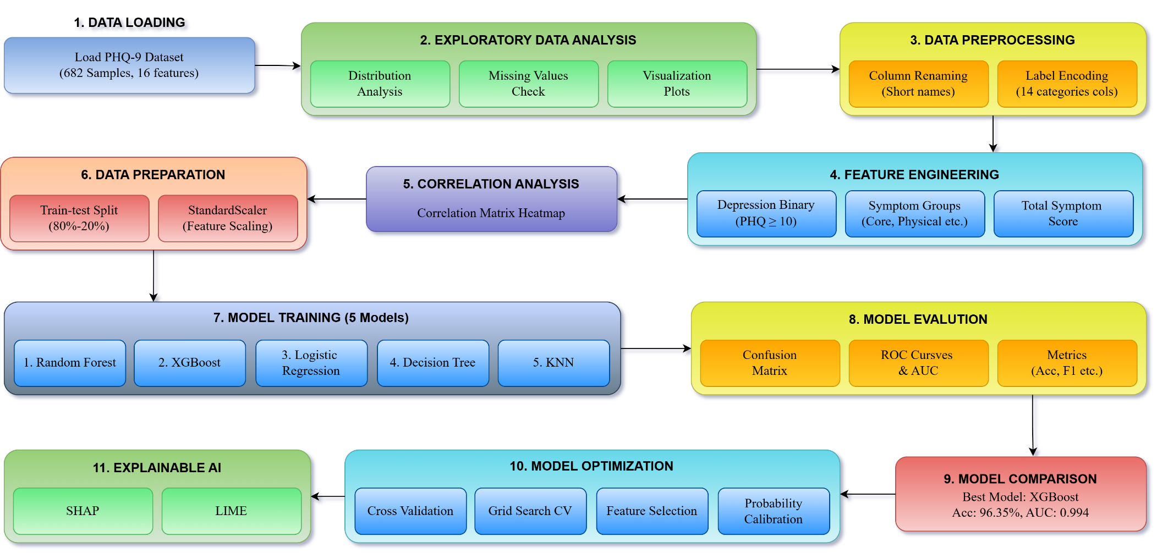
Methodology
Fig: PHQ-9 Methodology (Traditional ML) Pipeline
A Comparative Study of Mental Health Detection Using PHQ-9 and Social Media Analysis with Traditional ML and NLP Techniques
16

Slide 17
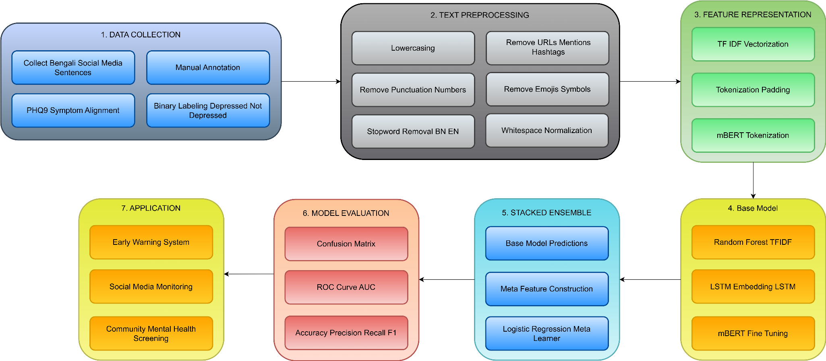
Methodology
Fig: PHQ-9 Methodology (NLP) Pipeline
A Comparative Study of Mental Health Detection Using PHQ-9 and Social Media Analysis with Traditional ML and NLP Techniques
17

Slide 18
Result and Discussion
Table: Model Comparison (PHQ-9 traditional ML)
Class | Precession | Recall | F1-Score | Accuracy
Not Depressed | 0.96 | 0.97 | 0.97 | 0.9635
Depressed | 0.97 | 0.95 | 0.96 | 0.9743
A Comparative Study of Mental Health Detection Using PHQ-9 and Social Media Analysis with Traditional ML and NLP Techniques
18

Slide 19
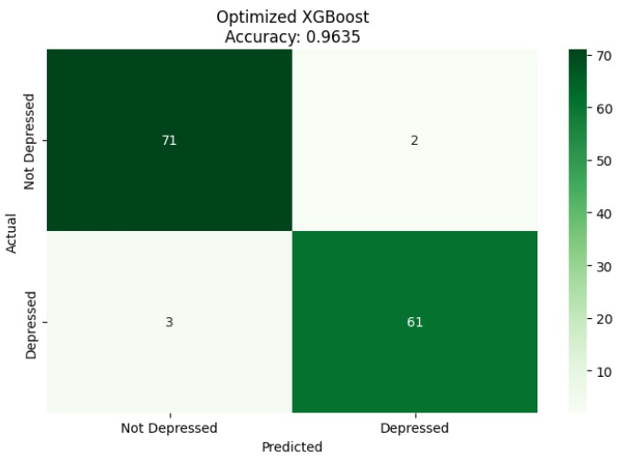
Result and Discussion
Fig: Confusion Matrix of Optimized XGBoost
A Comparative Study of Mental Health Detection Using PHQ-9 and Social Media Analysis with Traditional ML and NLP Techniques
19

Slide 20
Result and Discussion
Table: Model Comparison (PHQ-9 traditional ML)
Model | Accuracy | Precision | Recall | F1-Score | AUC-ROC
XGBoost | 0.9635 | 0.9683 | 0.9531 | 0.9606 | 0.9944
Random Forest | 0.8905 | 0.8889 | 0.8750 | 0.8819 | 0.9743
KNN | 0.8686 | 0.9792 | 0.7344 | 0.8393 | 0.9384
Decision Tree | 0.8613 | 0.8814 | 0.8125 | 0.8455 | 0.9325
Logistic Regression | 0.8394 | 0.9038 | 0.7344 | 0.8103 | 0.9360
A Comparative Study of Mental Health Detection Using PHQ-9 and Social Media Analysis with Traditional ML and NLP Techniques
20

Slide 21
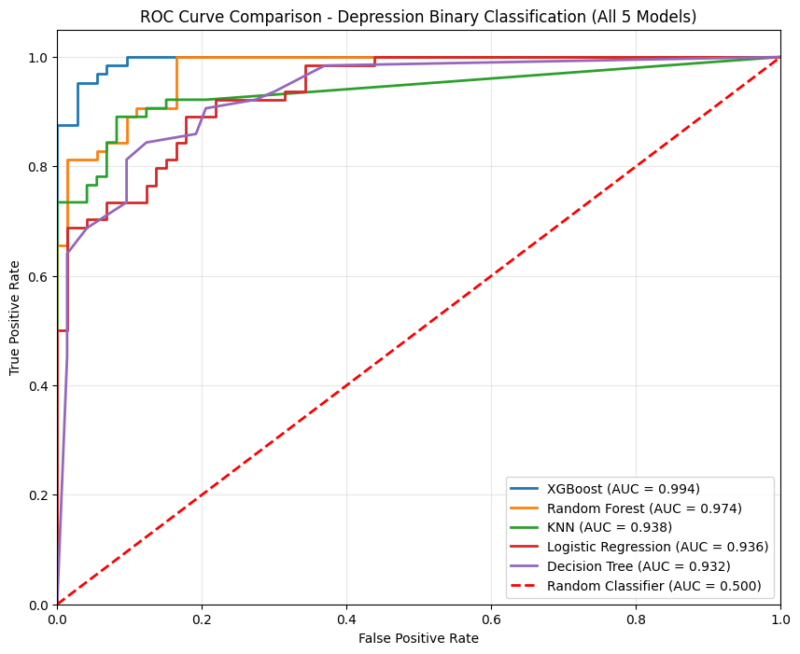
Result and Discussion
Fig: ROC Curve Comparison Across All Models
A Comparative Study of Mental Health Detection Using PHQ-9 and Social Media Analysis with Traditional ML and NLP Techniques
21

Slide 22
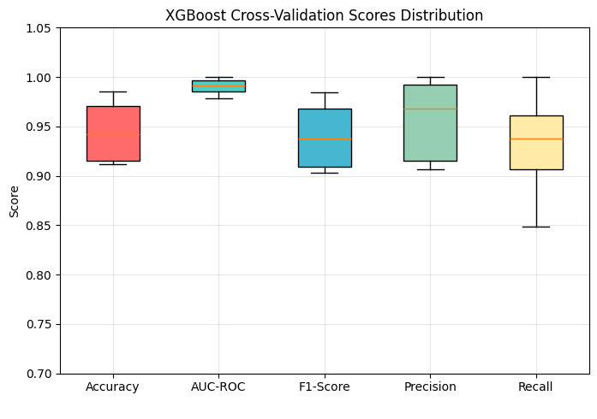
Result and Discussion
Fig: XGBoost Cross Validation Fold Accuracy Distribution
A Comparative Study of Mental Health Detection Using PHQ-9 and Social Media Analysis with Traditional ML and NLP Techniques
22

Slide 23
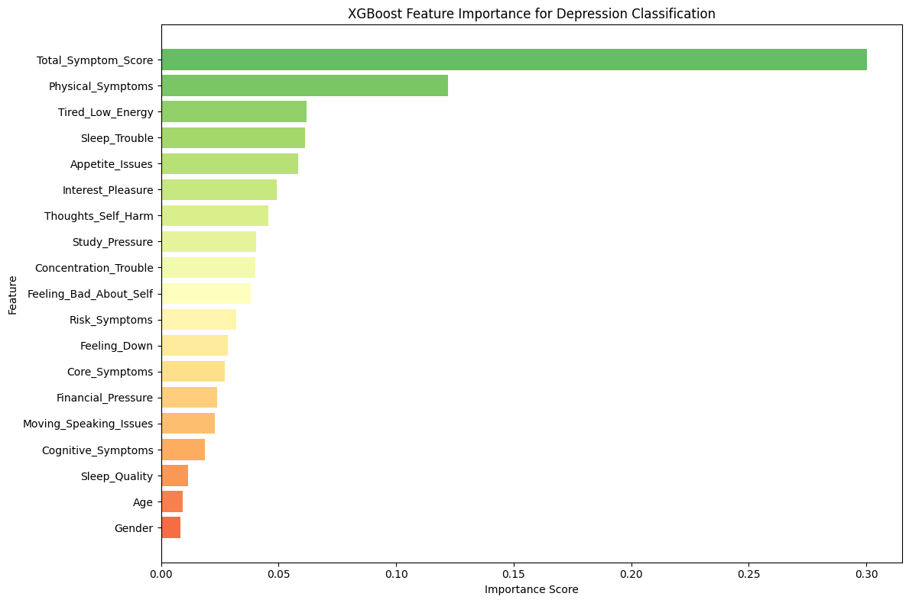
Result and Discussion
Fig: XGBoost Feature Importance
A Comparative Study of Mental Health Detection Using PHQ-9 and Social Media Analysis with Traditional ML and NLP Techniques
23

Slide 24
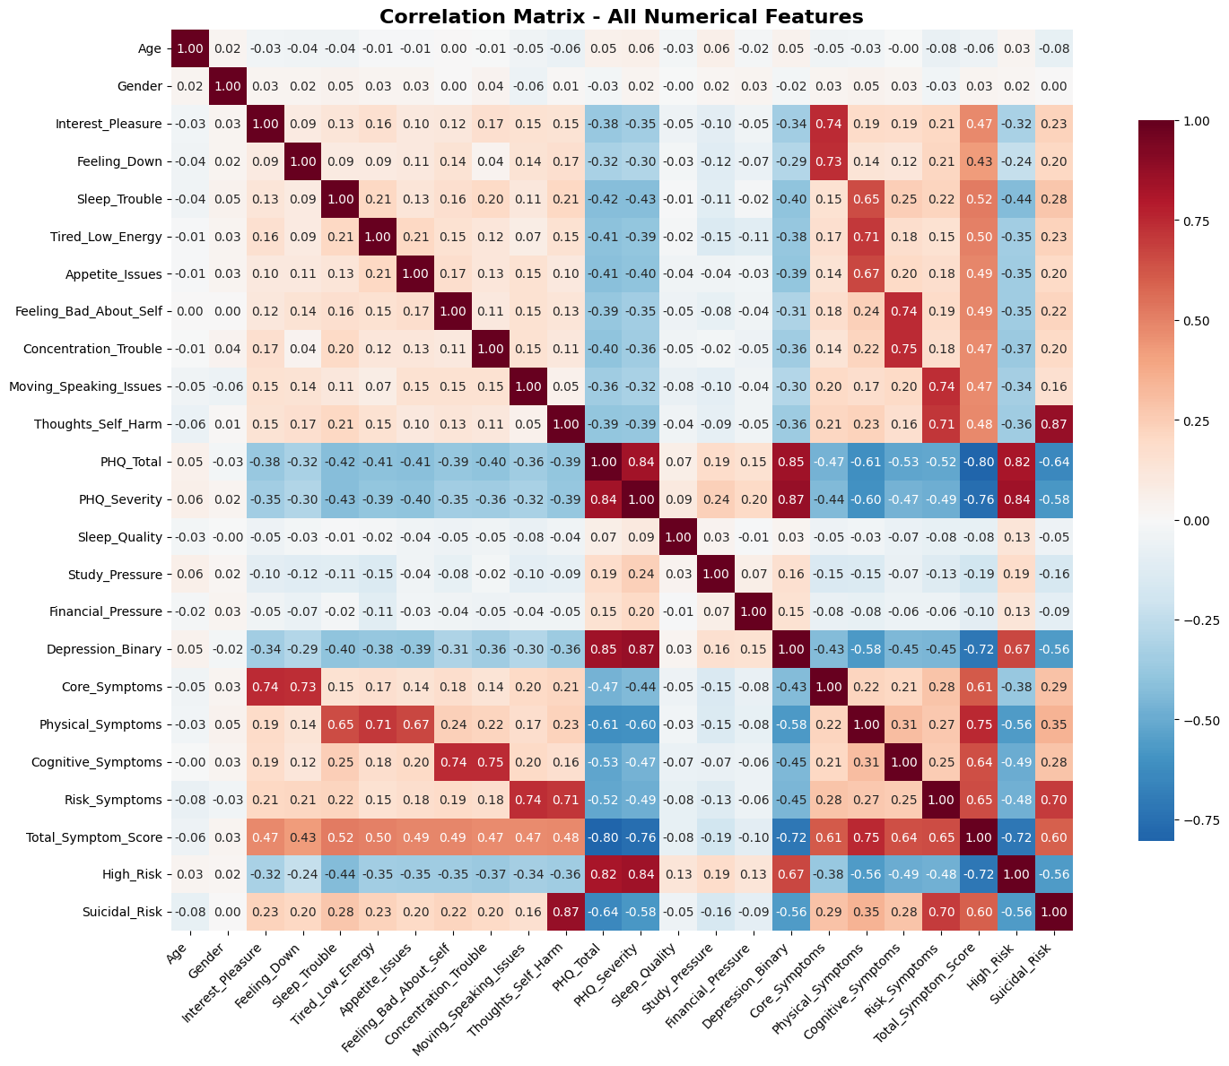
Result and Discussion
Fig: Correlation Matrix
A Comparative Study of Mental Health Detection Using PHQ-9 and Social Media Analysis with Traditional ML and NLP Techniques
24

Slide 25
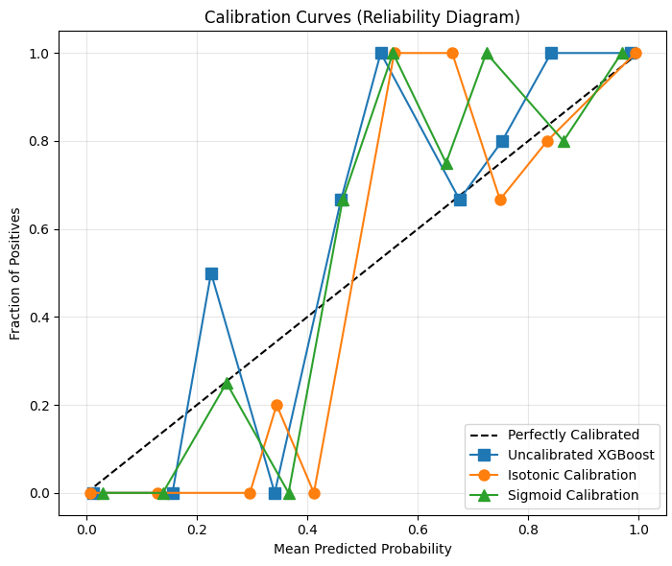
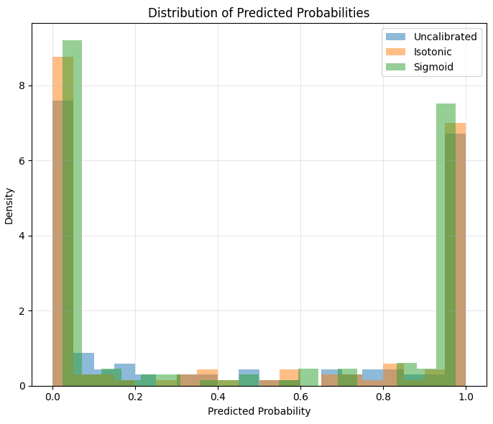
Result and Discussion
Fig: Probability Calibration Analysis and Predictive Reliability Distribution
A Comparative Study of Mental Health Detection Using PHQ-9 and Social Media Analysis with Traditional ML and NLP Techniques
25

Slide 26
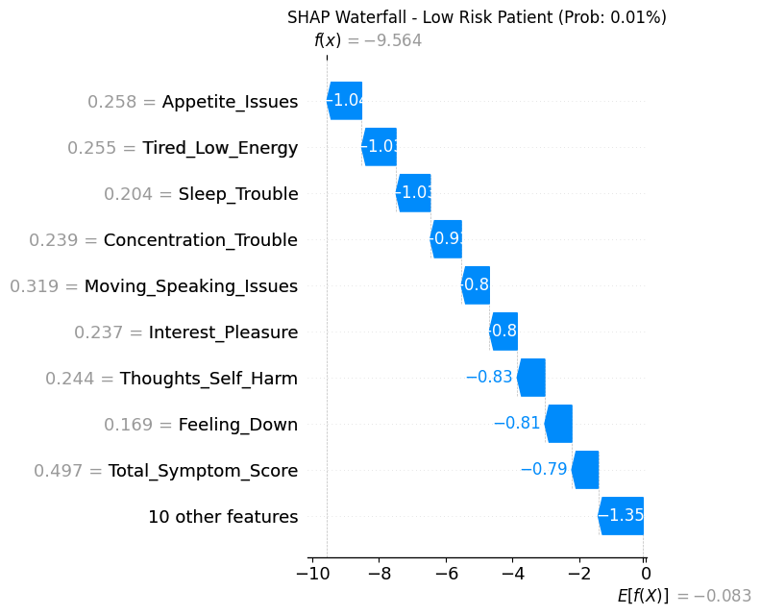
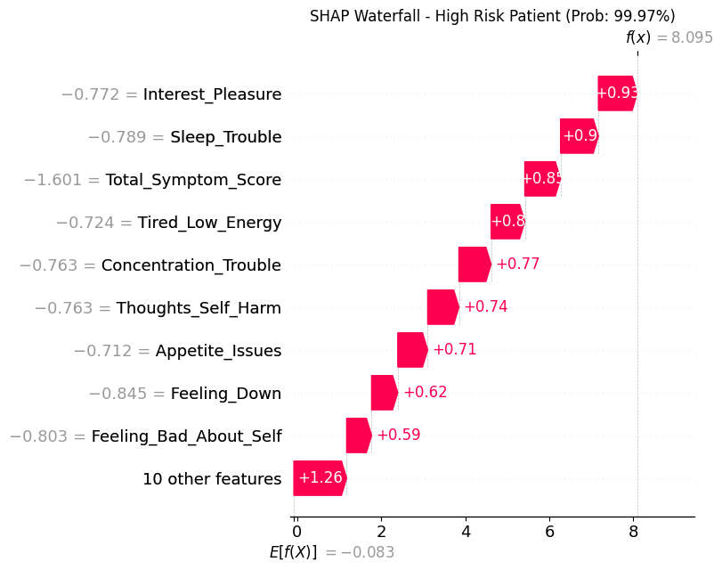
Result and Discussion
Fig: Local Interpretability Via SHAP waterfall
A Comparative Study of Mental Health Detection Using PHQ-9 and Social Media Analysis with Traditional ML and NLP Techniques
26

Slide 27
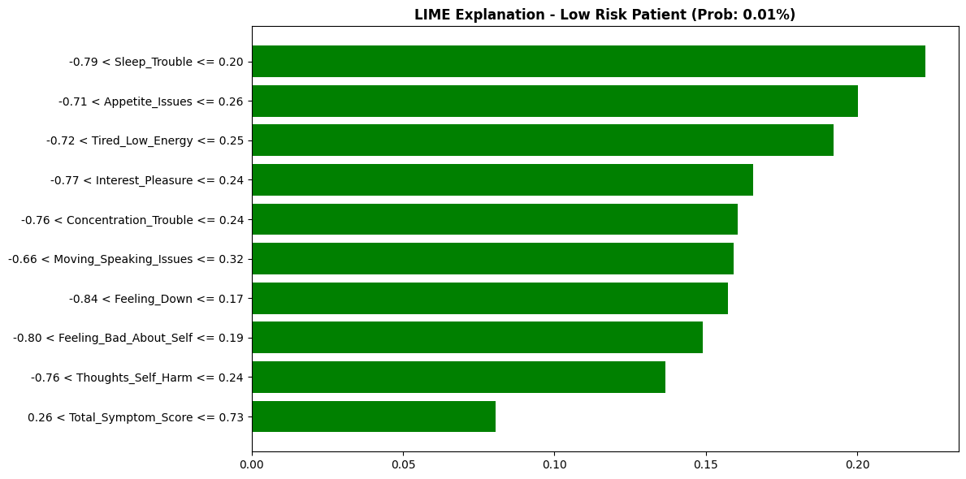
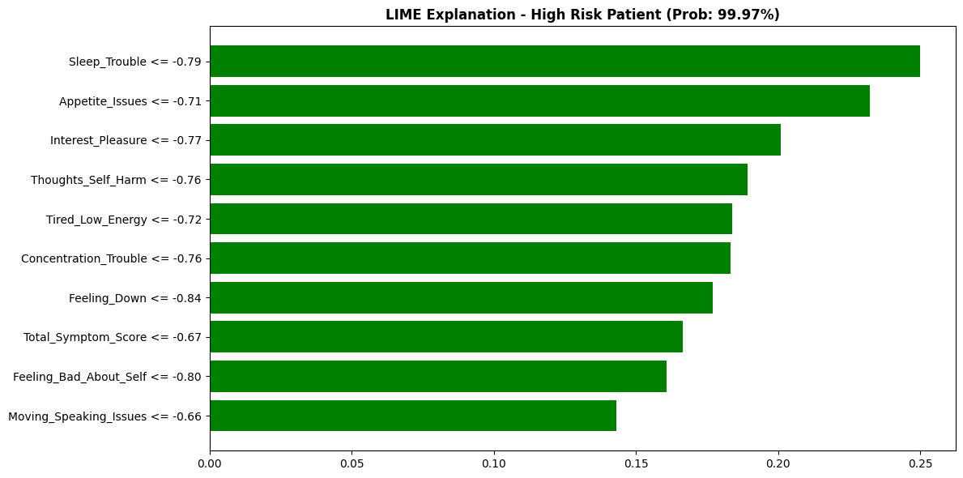
Result and Discussion
Fig: LIME Local Interpretability
A Comparative Study of Mental Health Detection Using PHQ-9 and Social Media Analysis with Traditional ML and NLP Techniques
27

Slide 28
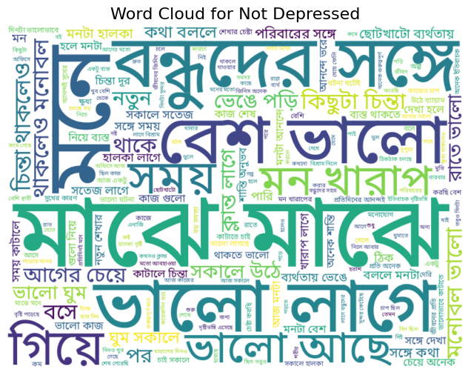
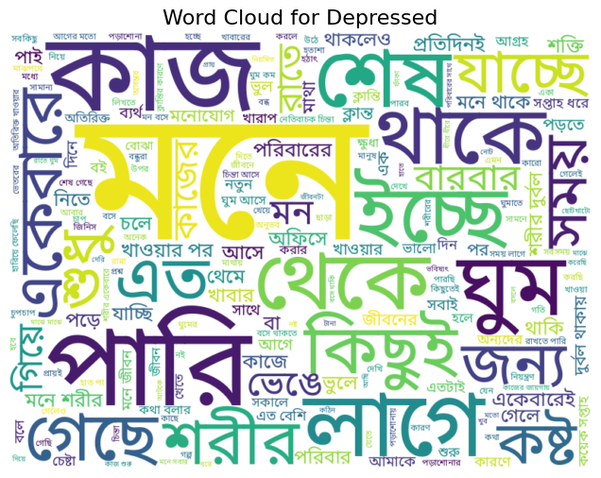
Result and Discussion
Fig: Word Cloud
A Comparative Study of Mental Health Detection Using PHQ-9 and Social Media Analysis with Traditional ML and NLP Techniques
28

Slide 29
Result and Discussion
Table: Base Models vs Ensemble Performance
Model | Accuracy | Precision (D) | Recall (D) | F1-Score (D) | Precision (ND) | Recall (ND) | F1-Score (ND)
BERT | 0.9578 | 0.94 | 0.97 | 0.96 | 0.97 | 0.94 | 0.96
LSTM | 0.8103 | 0.80 | 0.82 | 0.81 | 0.82 | 0.80 | 0.81
Random Forest | 0.7728 | 0.76 | 0.80 | 0.78 | 0.79 | 0.75 | 0.77
Ensemble | 0.9578 | 0.95 | 0.96 | 0.96 | 0.96 | 0.95 | 0.96
A Comparative Study of Mental Health Detection Using PHQ-9 and Social Media Analysis with Traditional ML and NLP Techniques
29

Slide 30
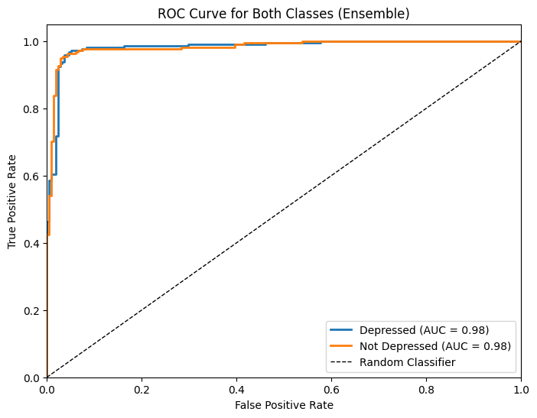
Result and Discussion
Fig: ROC Curve for Ensemble Model
A Comparative Study of Mental Health Detection Using PHQ-9 and Social Media Analysis with Traditional ML and NLP Techniques
30

Slide 31
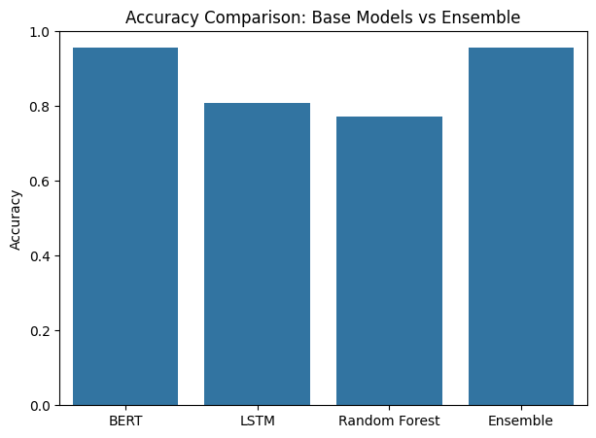
Result and Discussion
Fig: Accuracy Comparison between Base Models and Ensemble Approach
A Comparative Study of Mental Health Detection Using PHQ-9 and Social Media Analysis with Traditional ML and NLP Techniques
31

Slide 32
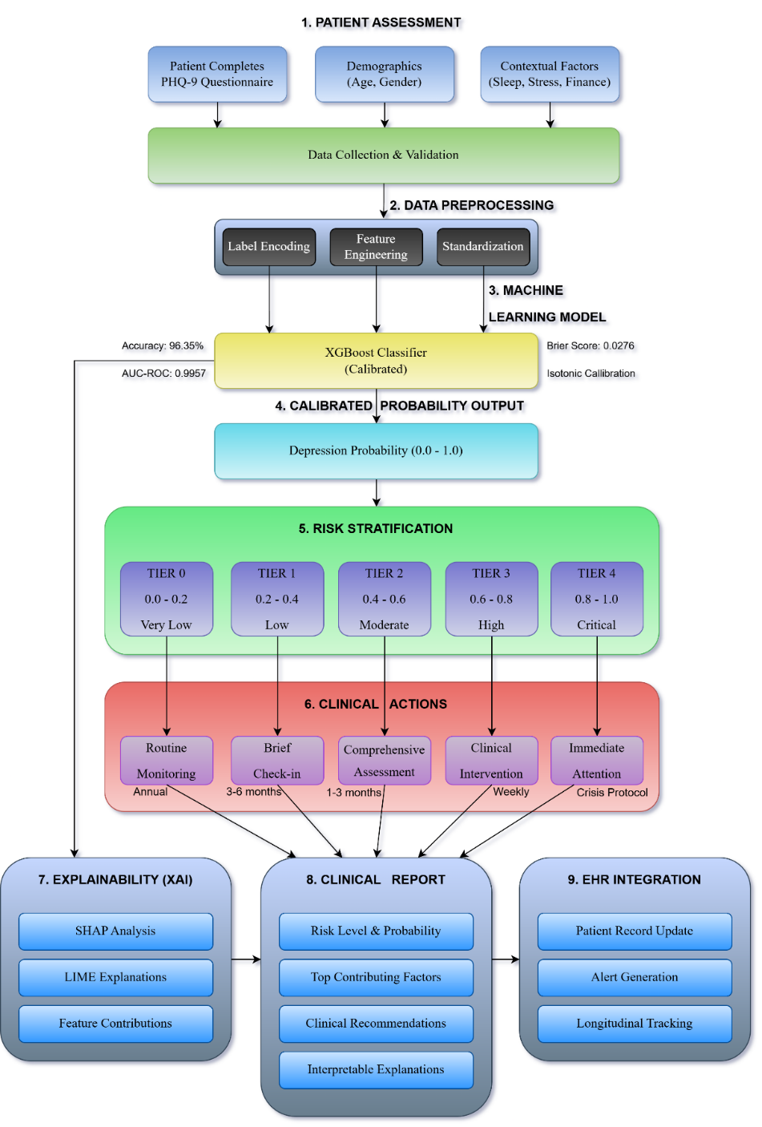
Result and Discussion
Fig: Clinical Decision System Support Workflow for Model Integration
A Comparative Study of Mental Health Detection Using PHQ-9 and Social Media Analysis with Traditional ML and NLP Techniques
32

Slide 33
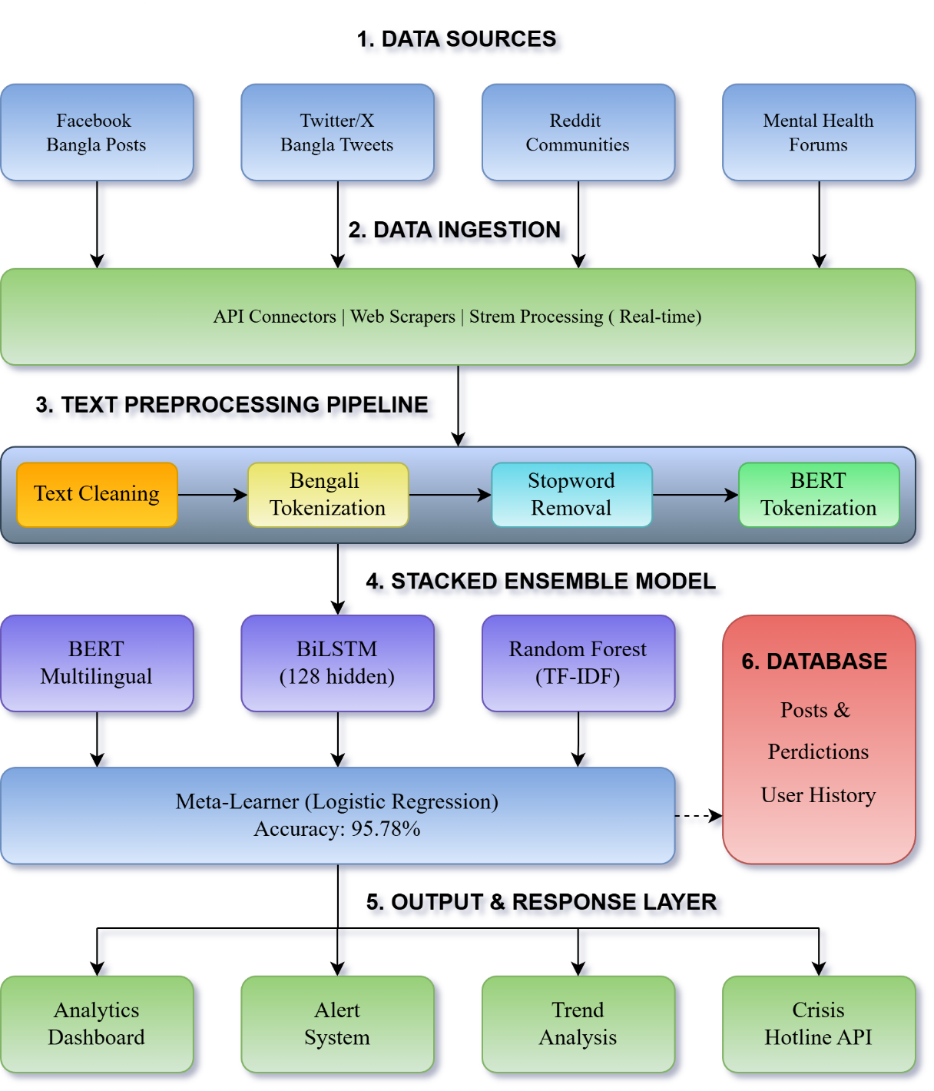
Result and Discussion
Fig: System Architecture for Social Media Health Monitoring
A Comparative Study of Mental Health Detection Using PHQ-9 and Social Media Analysis with Traditional ML and NLP Techniques
33

Slide 34
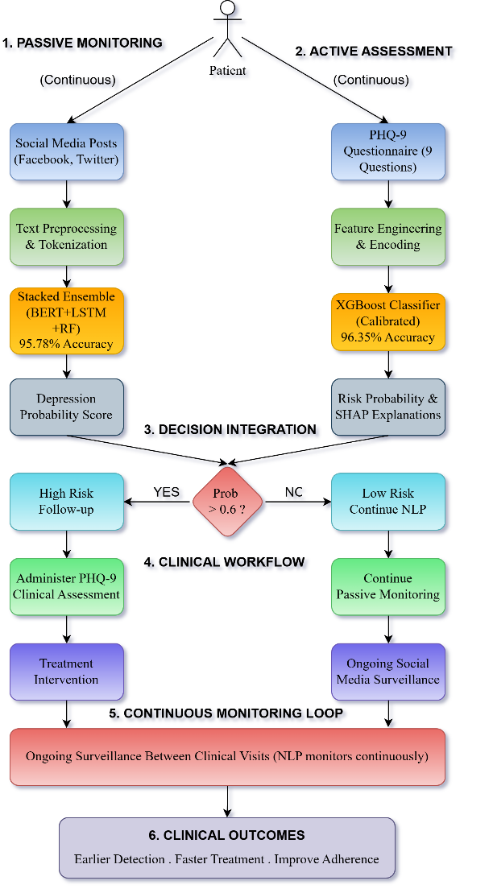
Result and Discussion
Fig: Dual Modality Depression Screening
A Comparative Study of Mental Health Detection Using PHQ-9 and Social Media Analysis with Traditional ML and NLP Techniques
34

Slide 35
Result and Discussion
Table: Summary of Our Approach
Aspect | PHQ-9 Based ML | Bengali social media NLP
Dataset | 682 Bangladeshi university students | 2,841 manually curated Bengali sentences
Models Used | Logistic Regression, DT, KNN, RF, XGBoost | RF (TF-IDF), LSTM, mBERT, Stacked Ensemble
Best Model | XGBoost | Stacked Ensemble (mBERT + LSTM + RF)
Accuracy | 96.35% | 95.78%
AUC-ROC | 0.9944 | High (ROC presented for BERT & ensemble)
Cross-Validation | 10-fold stratified | 80/20 split
Calibration | Isotonic + Platt Scaling | Not emphasized
Explainability | SHAP + LIME | Limited (mainly performance-based)
Novelty | Dual-modality comparative framework | Bengali low-resource transformer modeling
A Comparative Study of Mental Health Detection Using PHQ-9 and Social Media Analysis with Traditional ML and NLP Techniques
35

Slide 36
Result and Discussion
Table: Comparative Study with Previous Works
Study | Data Source | Methodology | Key Results | Comparison with Our Study
Haq et al. (2022) | Bangladeshi university students (PHQ-9 & GAD-7) | Traditional ML models (Random Forest, SVM) | Random Forest achieved the highest accuracy for depression prediction | This research applies to the same setting of population. Our methodology is better than that of our study because we introduce XGBoost, stratified cross-validation, probability calibration, and SHAP/LIME-generated interpretability.
Glavin et al. (2022, 2023) | PHQ-9 datasets | Feature optimization and item selection using ML | Optimized PHQ-9 item combinations improved screening efficiency | They base their work on the choice of fewer PHQ-9 items. Compared to that, our study extends the modeling by applying full-feature training and engineered symptom grouping and risk indicators.
Alves et al. (2025) | PHQ-9 + clinical notes (EMR) | Ensemble ML combining structured and unstructured data | High AUC values and scalable automated screening | Here our activity is the only one that conducts a direct comparative study of structured PHQ-9 ML and Bengali social media NLP in one unified framework which makes our approach more robust.
A Comparative Study of Mental Health Detection Using PHQ-9 and Social Media Analysis with Traditional ML and NLP Techniques
36

Slide 37
Result and Discussion
Table: Comparative Study with Previous Works (Contd.)
Study | Data Source | Methodology | Key Results | Comparison with Our Study
Colledani et al. (2024) | PHQ-9 + demographics | Decision Tree models for personalized assessment | Clinically interpretable decision paths | They are concerned with decision tree interpretability. Our results in XGBoost (96.35% accuracy) perform better on our study but we try to explain what happens using SHAP and LIME.
Hossain et al. (2022) | Bengali Facebook posts | LIWC + Random Forest | Identified depressive linguistic markers successfully | Their effort validates pointers of linguistic depression in Bengali. We promote it with LSTM and mBERT, and the stacked ensemble technique, and obtain 95.78% accuracy.
Skaik (2021) | Social media posts | Linguistic feature analysis | Population-level depression prediction was feasible | The main purpose of this work is to show the possibility of it. Our work offers a conscientious comparative analysis through use of transformer-based contextual modeling, as well as a more vigorous application of experimental validation to provide solid and dependable outcomes.
A Comparative Study of Mental Health Detection Using PHQ-9 and Social Media Analysis with Traditional ML and NLP Techniques
37

Slide 38
Result and Discussion
Table: Comparative Study with Previous Works (Contd.)
Study | Data Source | Methodology | Key Results | Comparison with Our Study
Razavi et al. (2020) | Smartphone and social metadata | ML classification models | Passive monitoring for depression detection was feasible | Their work is concerned with passive behavioral metadata. Our research is concerned with linguistic content and directly incorporates alignment with PHQ-9 based clinical screening.
Kim & Lee (2021) | PHQ-9 validated digital datasets | ML and BERT-based approaches | High pooled AUC values across studies | This paper summarizes the good performance of ML studies. We provide Bengali low-resource language modeling and a dual-feet comparative design.
A Comparative Study of Mental Health Detection Using PHQ-9 and Social Media Analysis with Traditional ML and NLP Techniques
38

Slide 39
Limitations
Dataset limited to Bangladeshi university students
Relies on self-reported and manually annotated data
Modeled as binary classification (no severity gradation)
Cross-sectional design (no longitudinal tracking)
NLP limited to short Bengali texts
Transformer models require GPU resources
A Comparative Study of Mental Health Detection Using PHQ-9 and Social Media Analysis with Traditional ML and NLP Techniques
39

Slide 40
Conclusion
Conducted a direct comparative study between PHQ-9–based ML and Bengali NLP–based depression detection
XGBoost (PHQ-9) achieved the highest performance (96.35% accuracy, 0.9944 AUC-ROC) with strong calibration and clear interpretability using SHAP and LIME.
The Bengali NLP Ensemble achieved 95.78% accuracy, effectively capturing depressive linguistic patterns from unstructured text.
PHQ-9 models - Clinically grounded & interpretable
NLP models - Scalable & passive monitoring capable
Proposed a dual-modality framework integrating both approaches
Publicly released two self-collected datasets for reproducibility
A Comparative Study of Mental Health Detection Using PHQ-9 and Social Media Analysis with Traditional ML and NLP Techniques
40

Slide 41
References
Abdullah, M.A.I.A. and Ahmed, S., 2026. PHQ-9 Annotated Social Media Posts Dataset for Automated Depression Severity Assessment. Mendeley Data, V1. Available at: https://doi.org/10.17632/fs2r7zvmj3.1
Alves, P., Marci, C.D., Cohen-Stavi, C.J., Whelan, K.M. and Boussios, C., 2025. A machine learning model using clinical notes to estimate PHQ-9 symptom severity scores in depressed patients. Journal of Affective Disorders, 376, pp.216–224.
Dey, S., Nawshin, A.T., Hossain, A. and Rahman, R.M., 2022. Machine learning combined with PHQ-9 for analyzing depression in Bangladeshi metropolitan areas. In: Proceedings of the IEEE Conference. Available at: https://doi.org/10.1109/is57118.2022.10019625
Glavin, D., Maekawa, E., Grua, E.M., Nakamura, C.A., Scazufca, M., Araya, R., Peters, T.J., Hollingworth, W. and van de Ven, P., 2022. Other PHQ-9 item pairings are better than the PHQ-2: A machine learning analysis. Procedia Computer Science, 206, pp.101–110.
Haq, I., Nayan, M.H., Uddin, M.G., Hossain, M., Alam, M., Zinnia, M., Rahman, M., Ria, R. and Haq Methun, M., 2022. Comparison of the performance of machine learning-based algorithms for predicting depression and anxiety among university students in Bangladesh. Asian Journal of Social Health and Behavior, 5(2), p.75.
Miraz, M.A.I.A., Mondal, S. and Ahmed, S., 2025. PHQ-9 Student Depression Dataset. Mendeley Data, V6. Available at: https://doi.org/10.17632/kkzjk253cy.6
A Comparative Study of Mental Health Detection Using PHQ-9 and Social Media Analysis with Traditional ML and NLP Techniques
41

Slide 42
Any Questions ?

Slide 43
Thank You

Slide 44
PHQ-9 Methodology (Traditional ML) Pipeline
A Comparative Study of Mental Health Detection Using PHQ-9 and Social Media Analysis with Traditional ML and NLP Techniques
44

Slide 45
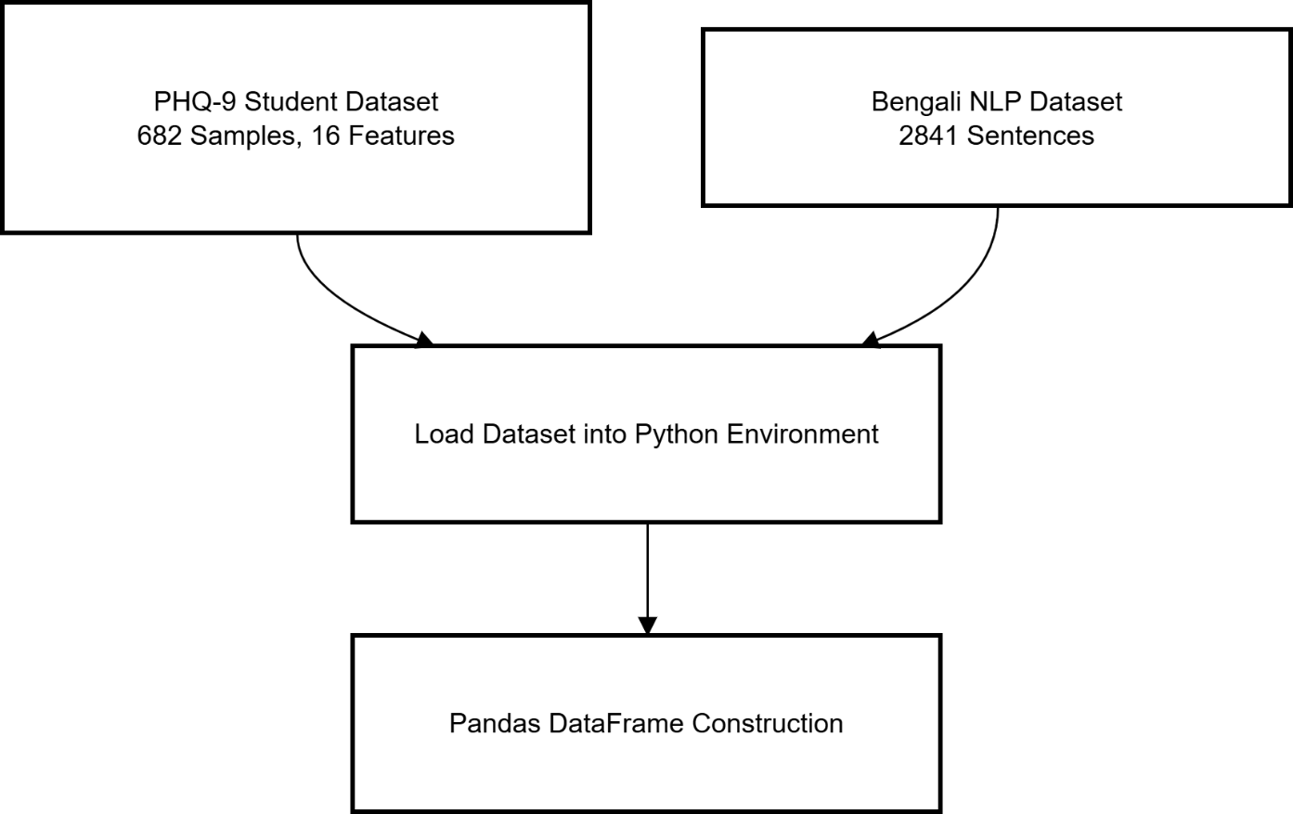
PHQ-9 Methodology (Traditional ML) Pipeline
Fig: Data Acquisition & Loading
A Comparative Study of Mental Health Detection Using PHQ-9 and Social Media Analysis with Traditional ML and NLP Techniques
45

Slide 46
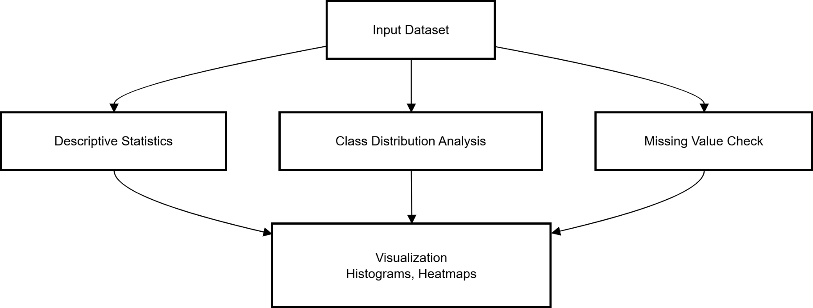
PHQ-9 Methodology (Traditional ML) Pipeline
Fig: Exploratory Data Analysis (EDA)
A Comparative Study of Mental Health Detection Using PHQ-9 and Social Media Analysis with Traditional ML and NLP Techniques
46

Slide 47
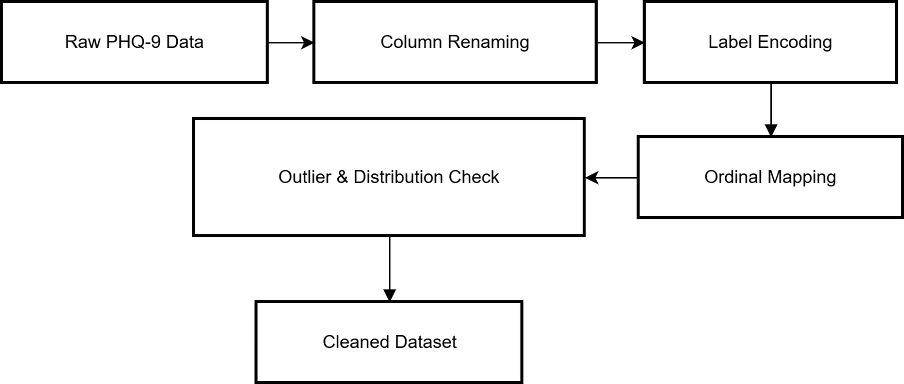
PHQ-9 Methodology (Traditional ML) Pipeline
Fig: Data Preprocessing (Structured PHQ-9)
A Comparative Study of Mental Health Detection Using PHQ-9 and Social Media Analysis with Traditional ML and NLP Techniques
47

Slide 48
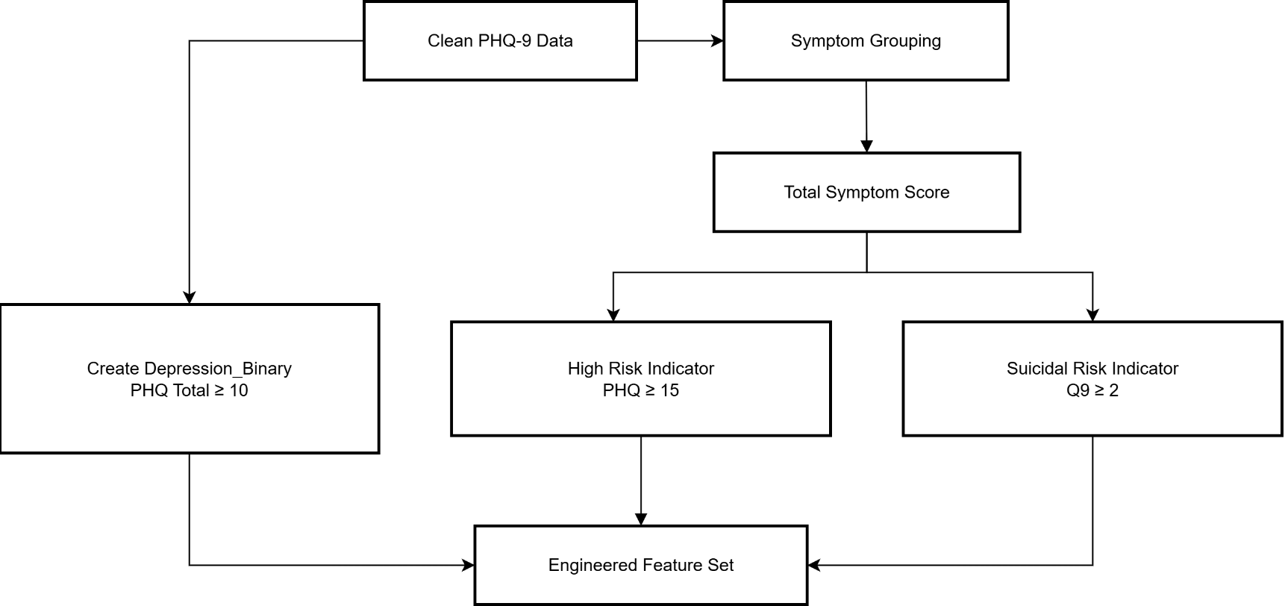
PHQ-9 Methodology (Traditional ML) Pipeline
Fig: Feature Engineering (PHQ-9)
A Comparative Study of Mental Health Detection Using PHQ-9 and Social Media Analysis with Traditional ML and NLP Techniques
48

Slide 49
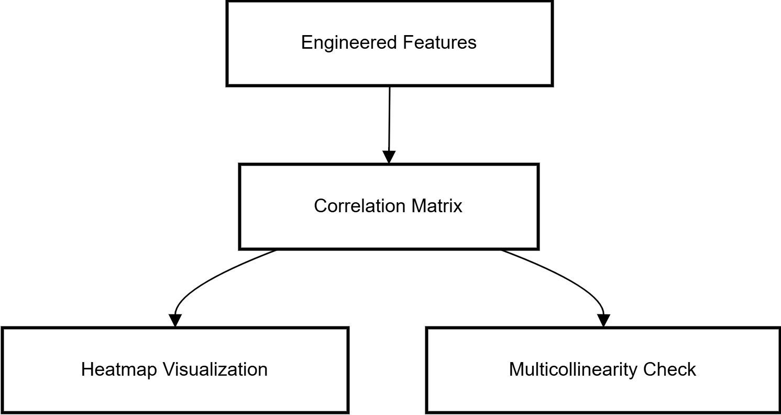
PHQ-9 Methodology (Traditional ML) Pipeline
Fig: Correlation Analysis
A Comparative Study of Mental Health Detection Using PHQ-9 and Social Media Analysis with Traditional ML and NLP Techniques
49

Slide 50
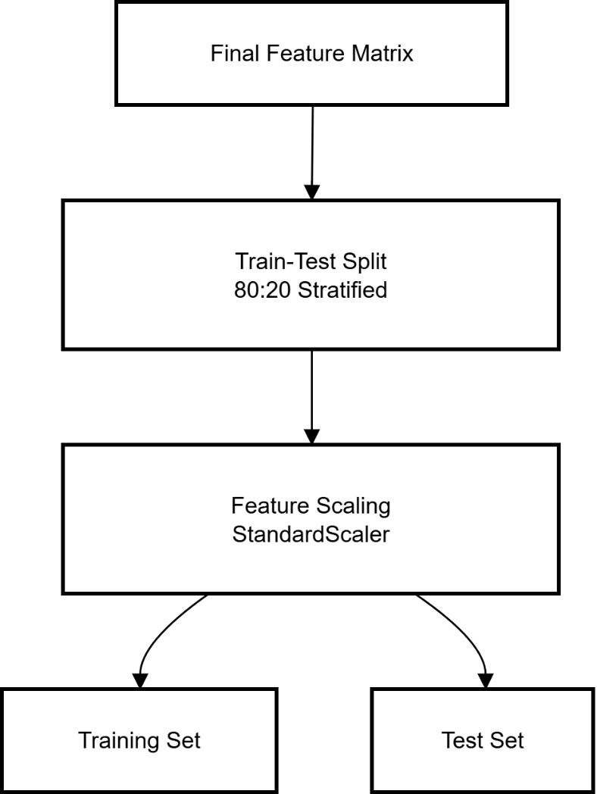
PHQ-9 Methodology (Traditional ML) Pipeline
Fig: Data Preparation for Training
A Comparative Study of Mental Health Detection Using PHQ-9 and Social Media Analysis with Traditional ML and NLP Techniques
50

Slide 51
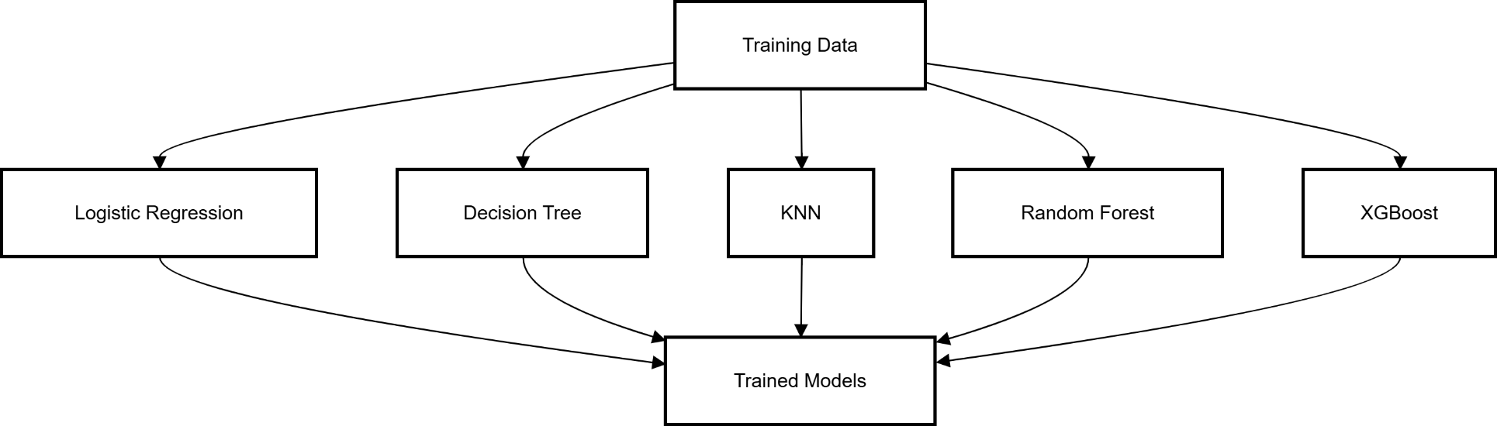
PHQ-9 Methodology (Traditional ML) Pipeline
Fig: Traditional ML Model Training (PHQ-9)
A Comparative Study of Mental Health Detection Using PHQ-9 and Social Media Analysis with Traditional ML and NLP Techniques
51

Slide 52
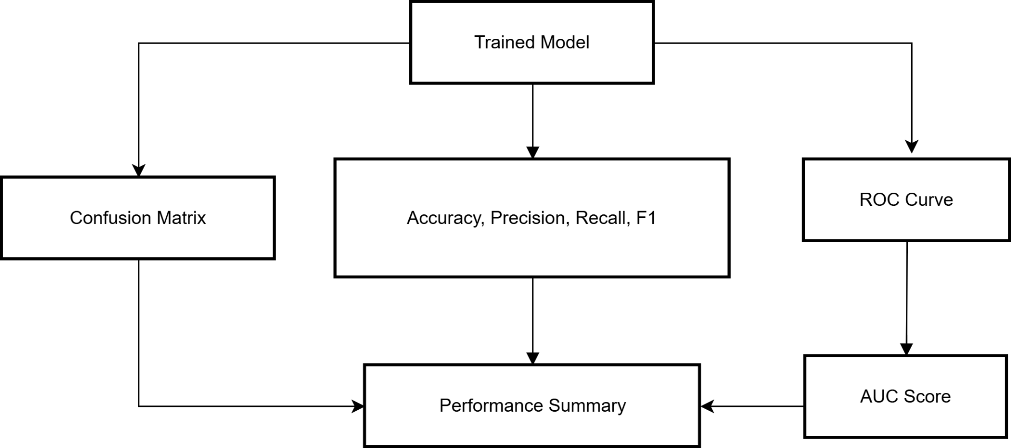
PHQ-9 Methodology (Traditional ML) Pipeline
Fig: Model Evaluation
A Comparative Study of Mental Health Detection Using PHQ-9 and Social Media Analysis with Traditional ML and NLP Techniques
52

Slide 53
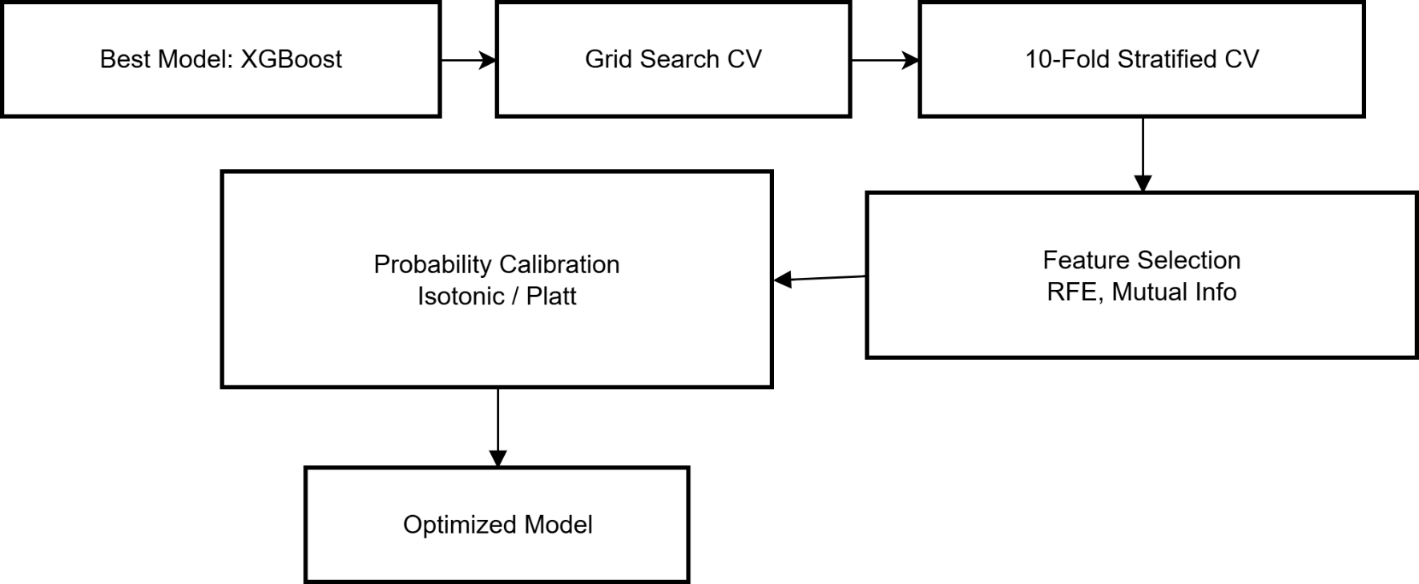
PHQ-9 Methodology (Traditional ML) Pipeline
Fig: Model Optimization
A Comparative Study of Mental Health Detection Using PHQ-9 and Social Media Analysis with Traditional ML and NLP Techniques
53

Slide 54
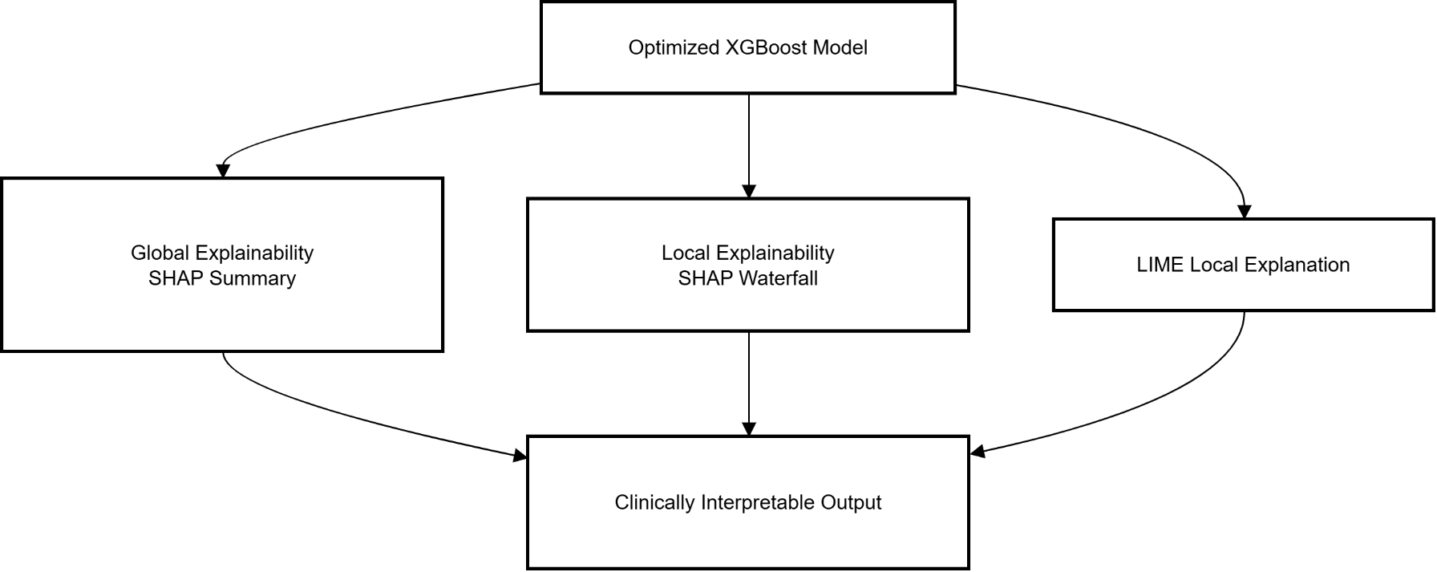
PHQ-9 Methodology (Traditional ML) Pipeline
Fig: Explainable AI
A Comparative Study of Mental Health Detection Using PHQ-9 and Social Media Analysis with Traditional ML and NLP Techniques
54

Slide 55
PHQ-9 Methodology (NLP) Pipeline
A Comparative Study of Mental Health Detection Using PHQ-9 and Social Media Analysis with Traditional ML and NLP Techniques
55

Slide 56
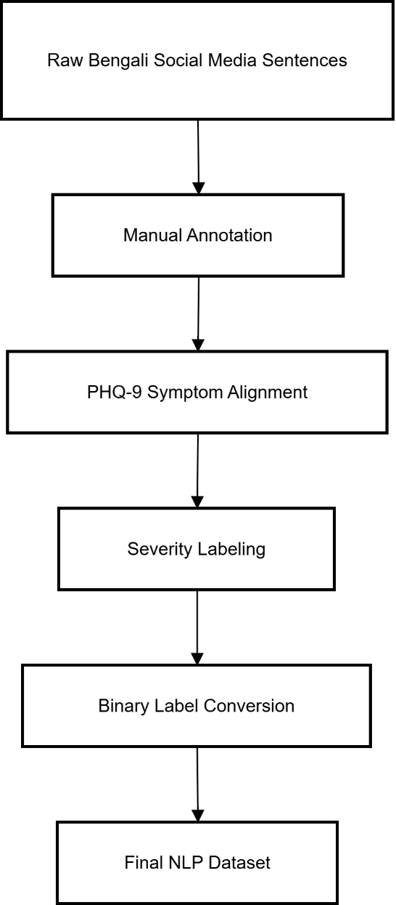
PHQ-9 Methodology (NLP) Pipeline
Fig: Dataset Construction Module
A Comparative Study of Mental Health Detection Using PHQ-9 and Social Media Analysis with Traditional ML and NLP Techniques
56

Slide 57
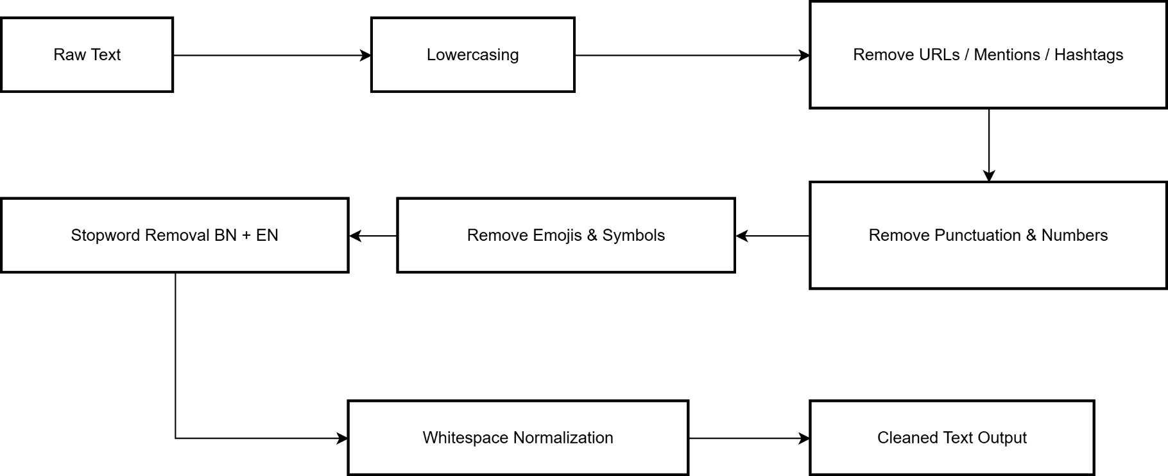
PHQ-9 Methodology (NLP) Pipeline
Fig: Text Preprocessing Module
A Comparative Study of Mental Health Detection Using PHQ-9 and Social Media Analysis with Traditional ML and NLP Techniques
57

Slide 58
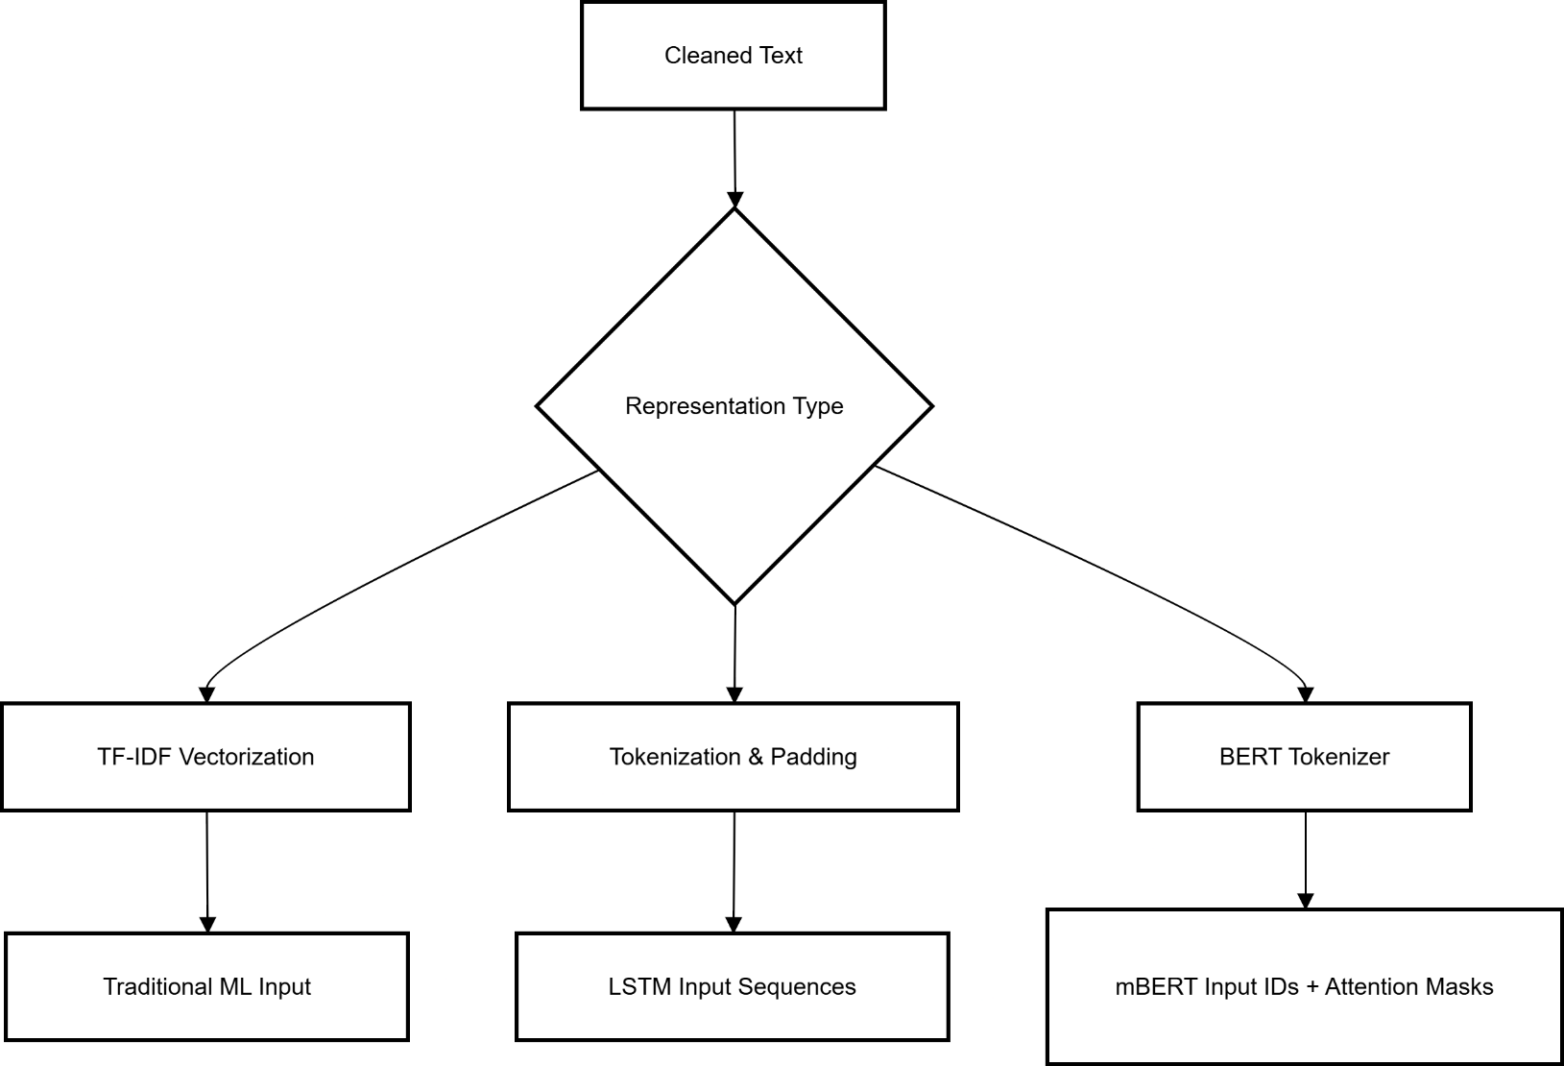
PHQ-9 Methodology (NLP) Pipeline
Fig: Feature Representation Module
A Comparative Study of Mental Health Detection Using PHQ-9 and Social Media Analysis with Traditional ML and NLP Techniques
58

Slide 59
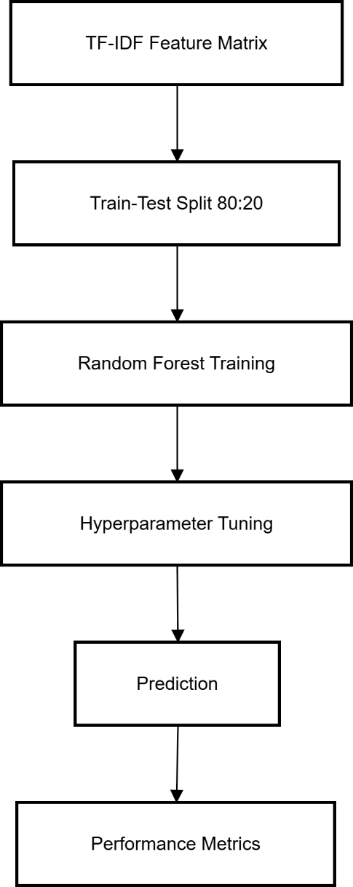
PHQ-9 Methodology (NLP) Pipeline
Fig: Random Forest (TF-IDF) Module
A Comparative Study of Mental Health Detection Using PHQ-9 and Social Media Analysis with Traditional ML and NLP Techniques
59

Slide 60
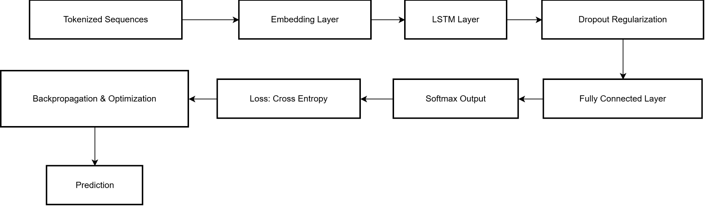
PHQ-9 Methodology (NLP) Pipeline
Fig: LSTM Deep Learning Module
A Comparative Study of Mental Health Detection Using PHQ-9 and Social Media Analysis with Traditional ML and NLP Techniques
60

Slide 61
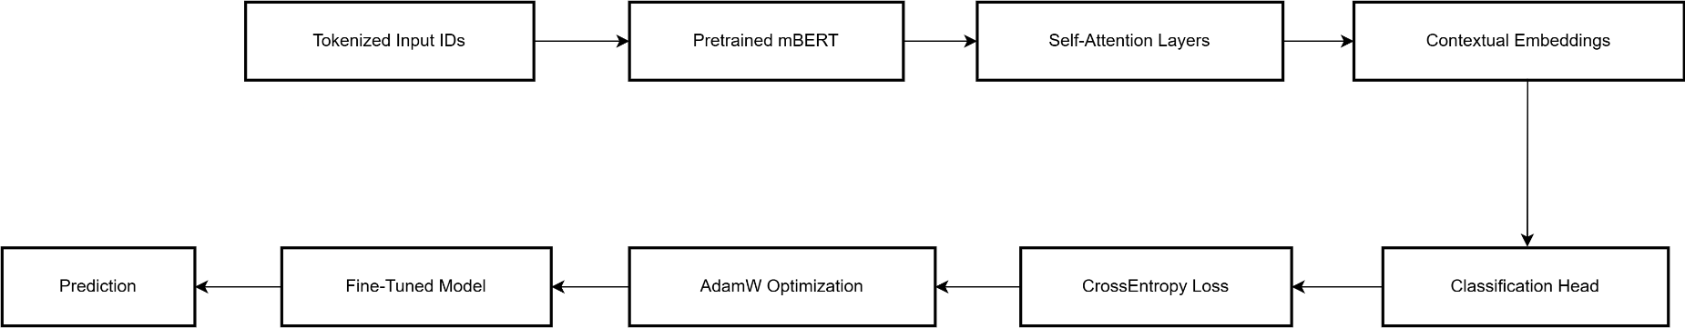
PHQ-9 Methodology (NLP) Pipeline
Fig: mBERT Transformer Module
A Comparative Study of Mental Health Detection Using PHQ-9 and Social Media Analysis with Traditional ML and NLP Techniques
61

Slide 62
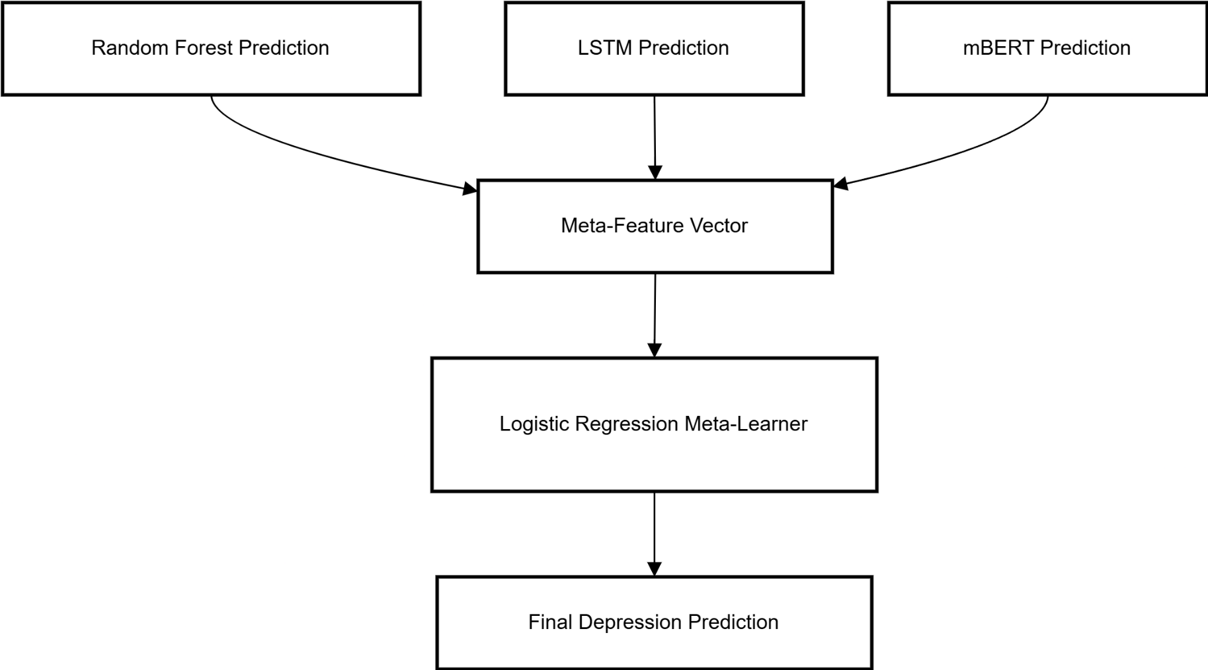
PHQ-9 Methodology (NLP) Pipeline
Fig: Stacked Ensemble (Meta-Learner) Module
A Comparative Study of Mental Health Detection Using PHQ-9 and Social Media Analysis with Traditional ML and NLP Techniques
62

Slide 63
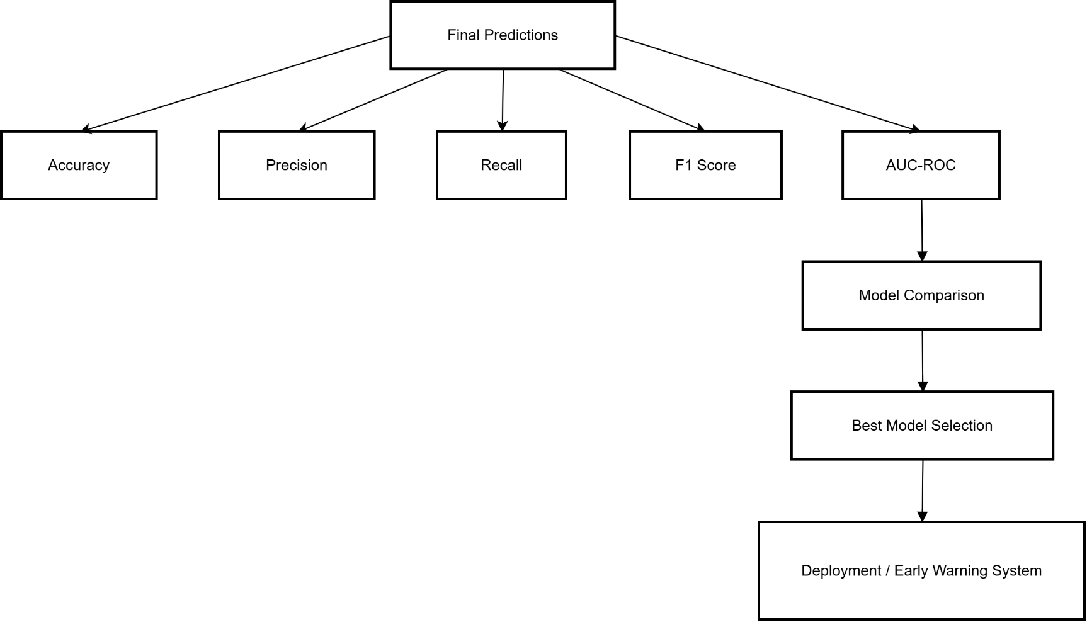
PHQ-9 Methodology (NLP) Pipeline
Fig: Evaluation & Deployment Module
A Comparative Study of Mental Health Detection Using PHQ-9 and Social Media Analysis with Traditional ML and NLP Techniques
63

Slide 64
Clinical Decision System Support Workflow for Model Integration
A Comparative Study of Mental Health Detection Using PHQ-9 and Social Media Analysis with Traditional ML and NLP Techniques
64

Slide 65
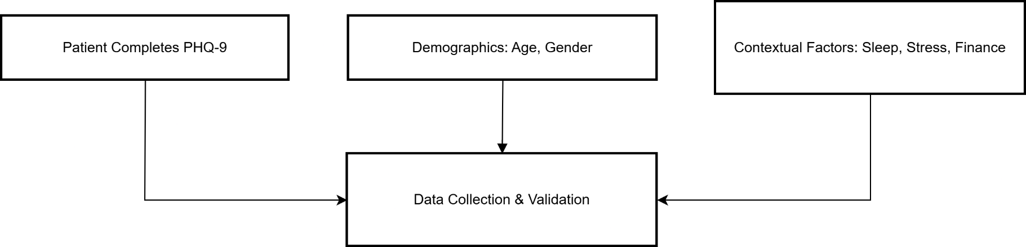
Clinical Decision System Support Workflow for Model Integration
Fig: Patient Assessment Module
A Comparative Study of Mental Health Detection Using PHQ-9 and Social Media Analysis with Traditional ML and NLP Techniques
65

Slide 66
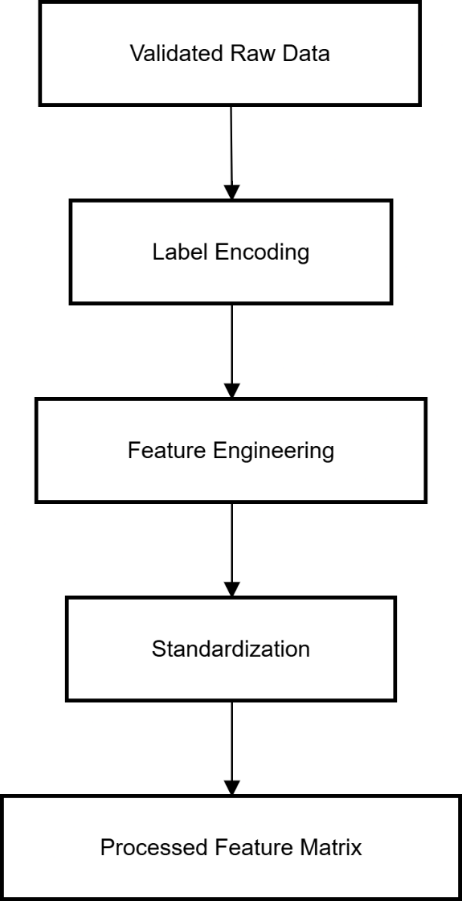
Clinical Decision System Support Workflow for Model Integration
Fig: Data Preprocessing Module
A Comparative Study of Mental Health Detection Using PHQ-9 and Social Media Analysis with Traditional ML and NLP Techniques
66

Slide 67
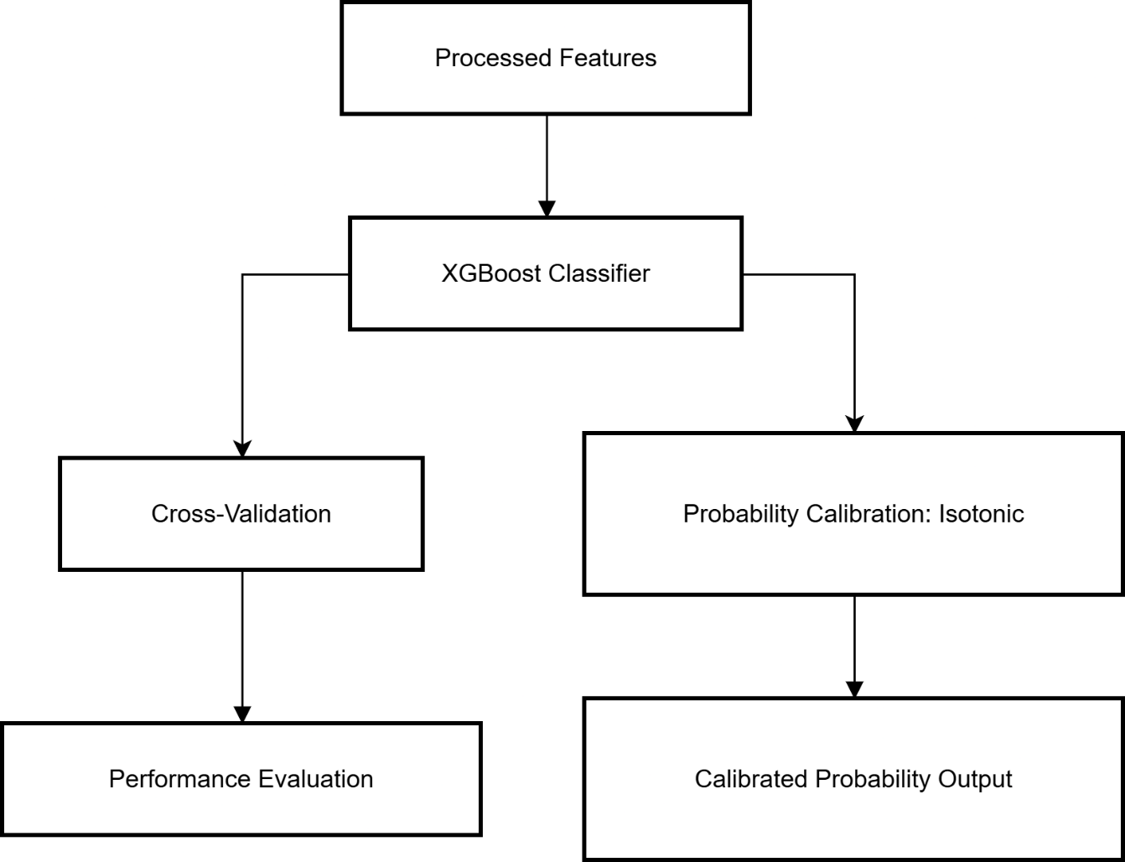
Clinical Decision System Support Workflow for Model Integration
Fig: Machine Learning & Calibration Module
A Comparative Study of Mental Health Detection Using PHQ-9 and Social Media Analysis with Traditional ML and NLP Techniques
67

Slide 68
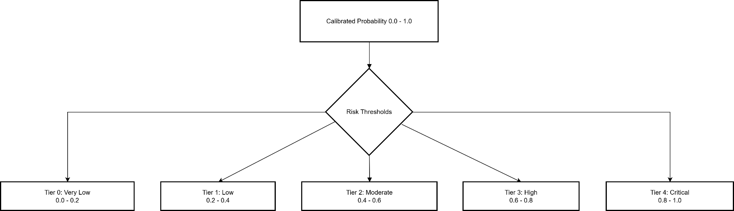
Clinical Decision System Support Workflow for Model Integration
Fig: Risk Stratification Module
A Comparative Study of Mental Health Detection Using PHQ-9 and Social Media Analysis with Traditional ML and NLP Techniques
68

Slide 69
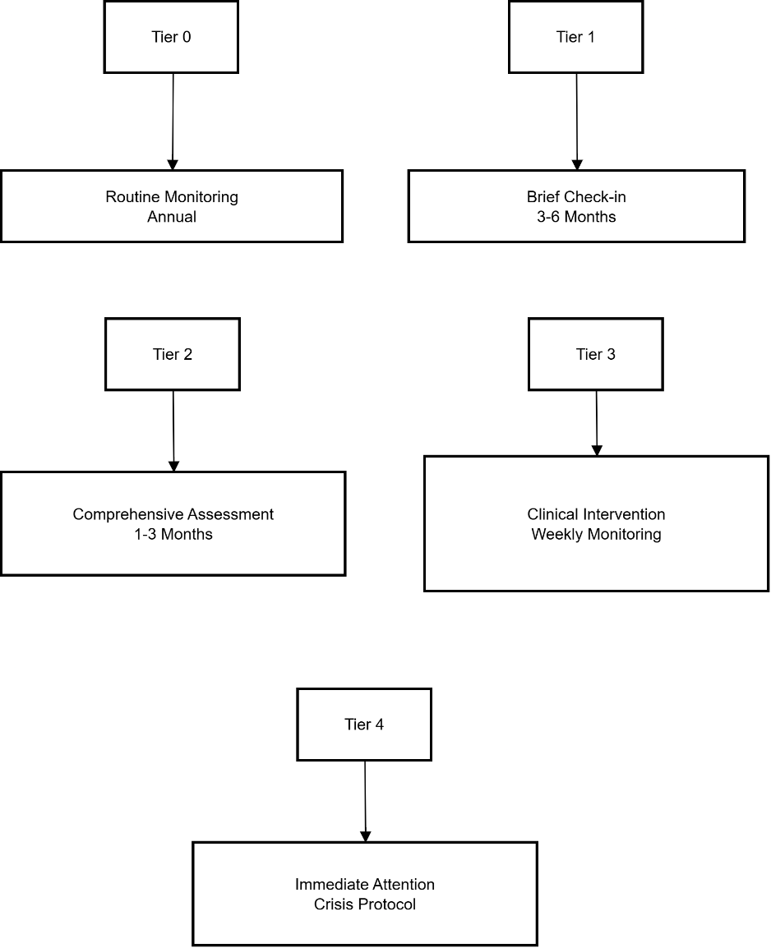
Clinical Decision System Support Workflow for Model Integration
Fig: Clinical Action Module
A Comparative Study of Mental Health Detection Using PHQ-9 and Social Media Analysis with Traditional ML and NLP Techniques
69

Slide 70
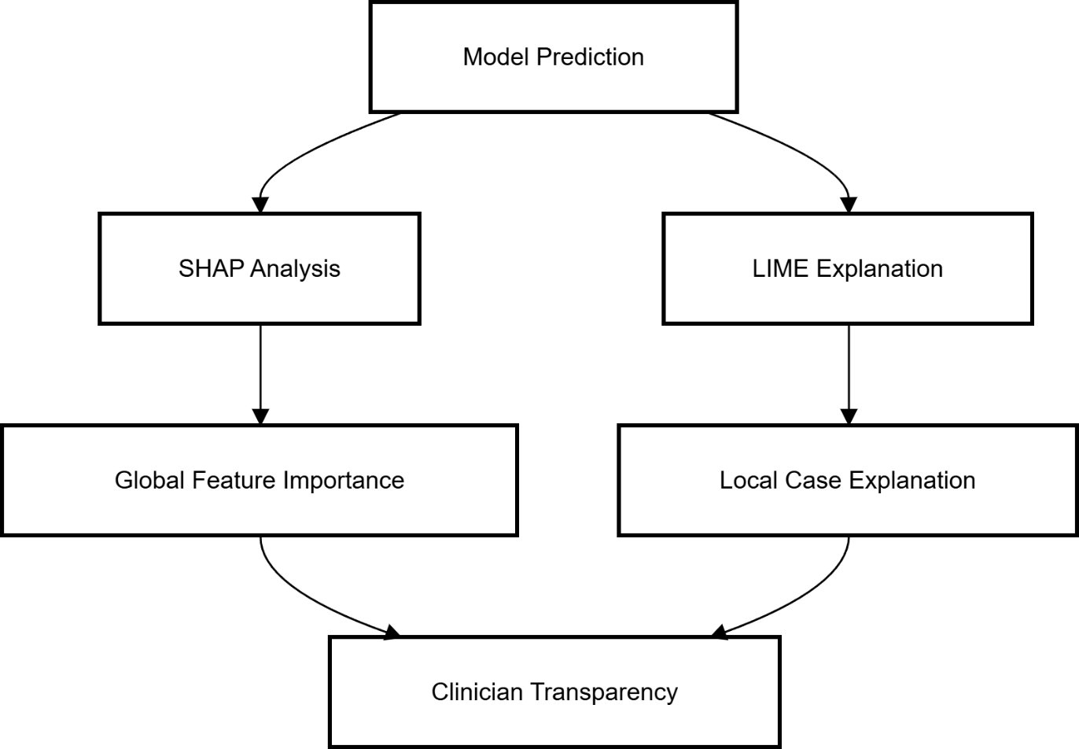
Clinical Decision System Support Workflow for Model Integration
Fig: Explainability (XAI) Module
A Comparative Study of Mental Health Detection Using PHQ-9 and Social Media Analysis with Traditional ML and NLP Techniques
70

Slide 71
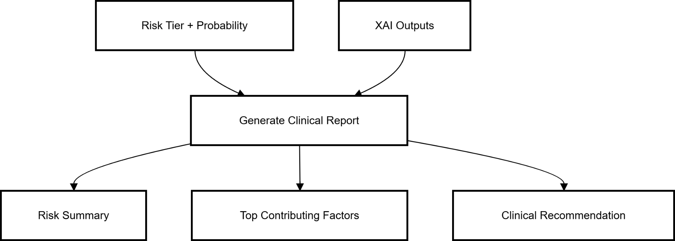
Clinical Decision System Support Workflow for Model Integration
Fig: Clinical Report Generation Module
A Comparative Study of Mental Health Detection Using PHQ-9 and Social Media Analysis with Traditional ML and NLP Techniques
71

Slide 72
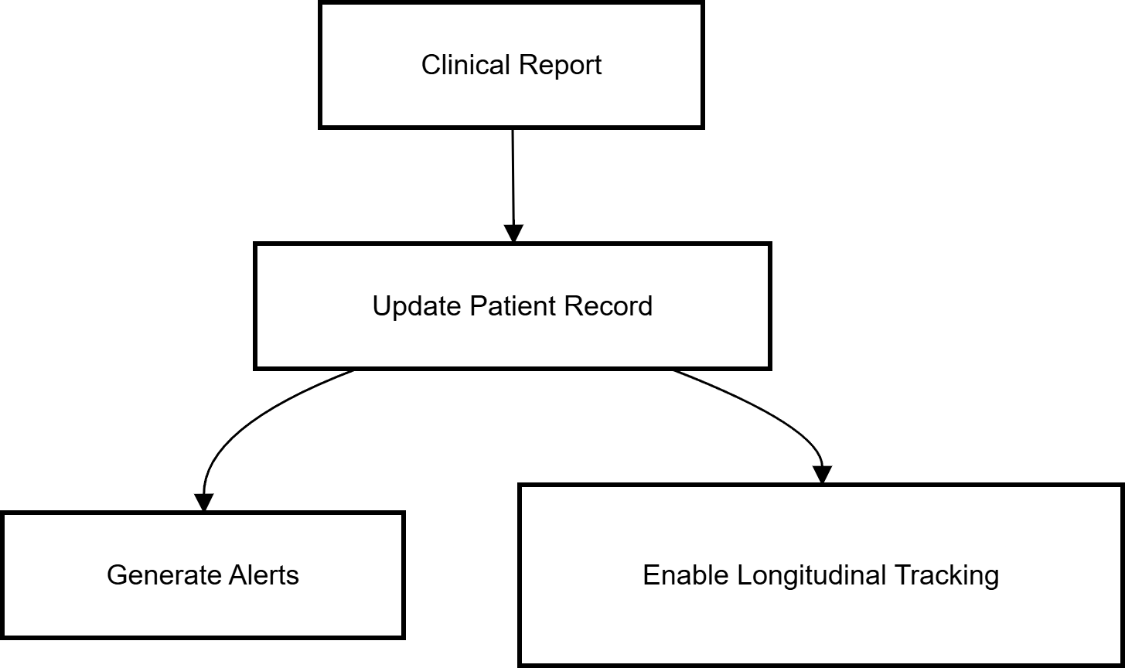
Clinical Decision System Support Workflow for Model Integration
Fig: EHR Integration Module
A Comparative Study of Mental Health Detection Using PHQ-9 and Social Media Analysis with Traditional ML and NLP Techniques
72

Slide 73
System Architecture for Social Media Health Monitoring
A Comparative Study of Mental Health Detection Using PHQ-9 and Social Media Analysis with Traditional ML and NLP Techniques
73

Slide 74
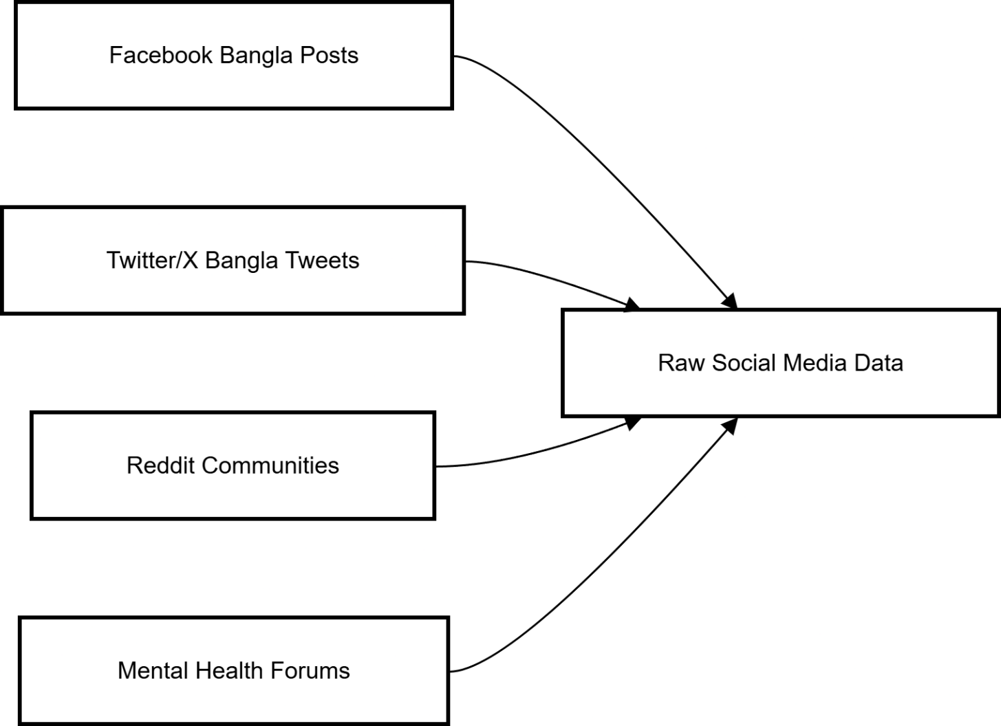
System Architecture for Social Media Health Monitoring
Fig: Data Source Layer
A Comparative Study of Mental Health Detection Using PHQ-9 and Social Media Analysis with Traditional ML and NLP Techniques
74

Slide 75
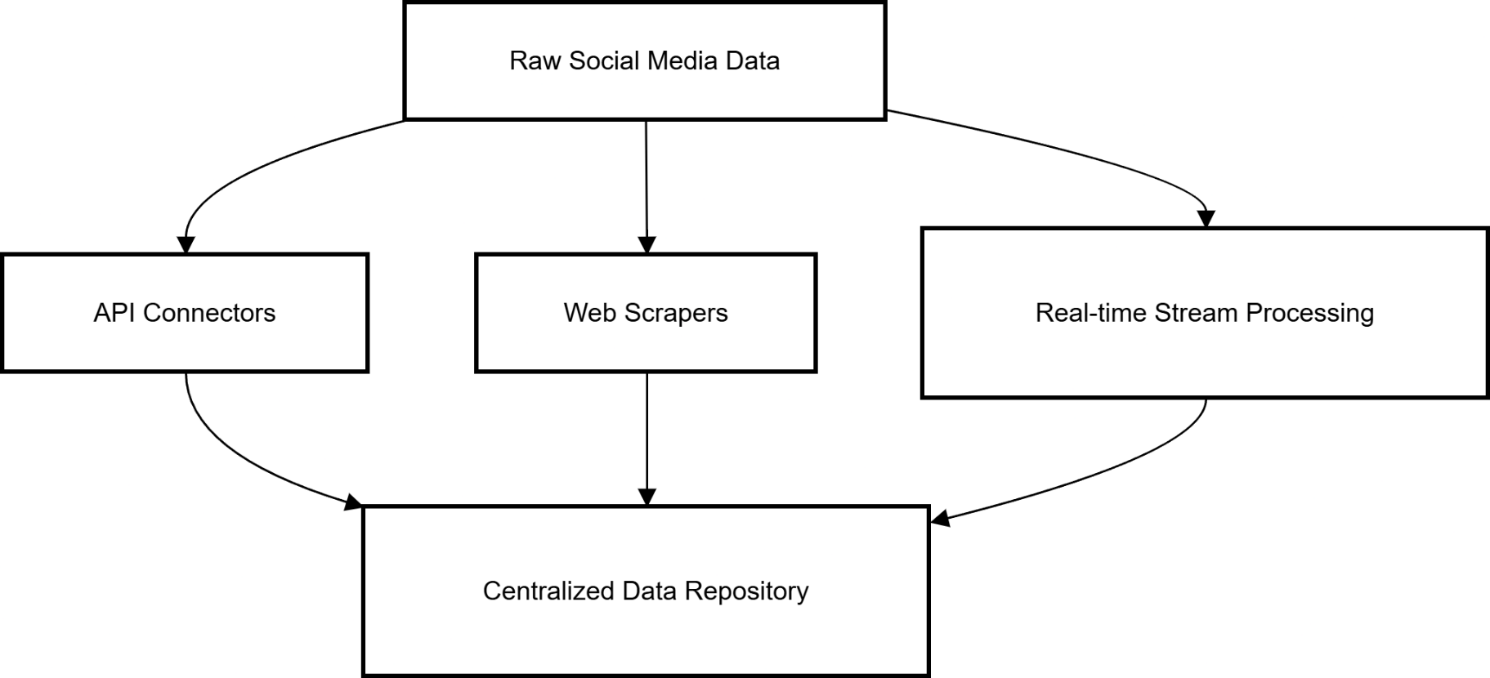
System Architecture for Social Media Health Monitoring
Fig: Data Ingestion Layer
A Comparative Study of Mental Health Detection Using PHQ-9 and Social Media Analysis with Traditional ML and NLP Techniques
75

Slide 76
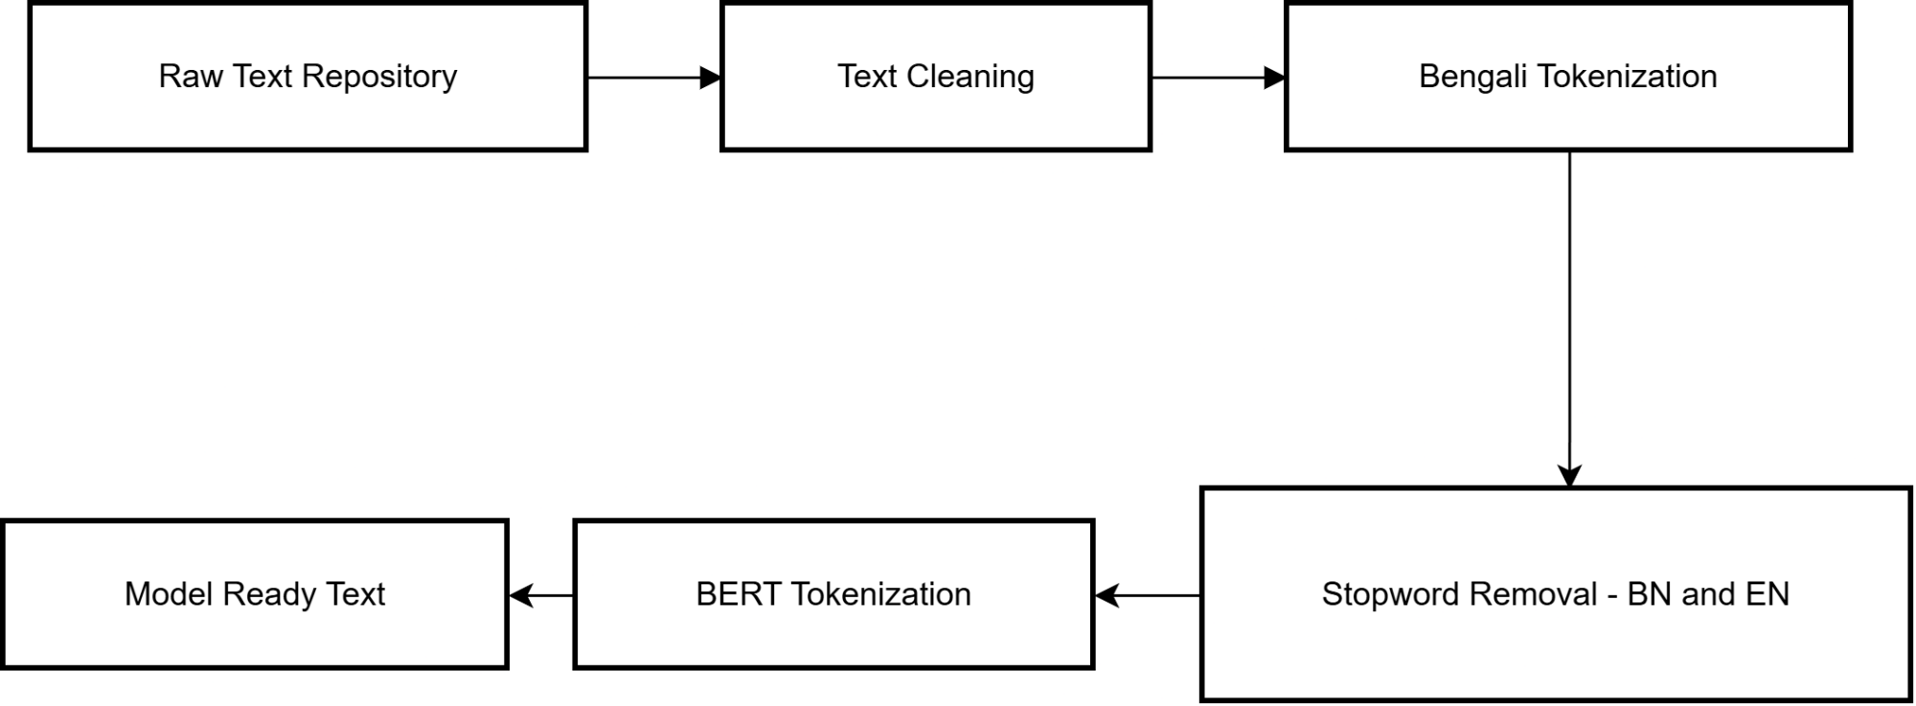
System Architecture for Social Media Health Monitoring
Fig: Text Preprocessing Pipeline
A Comparative Study of Mental Health Detection Using PHQ-9 and Social Media Analysis with Traditional ML and NLP Techniques
76

Slide 77
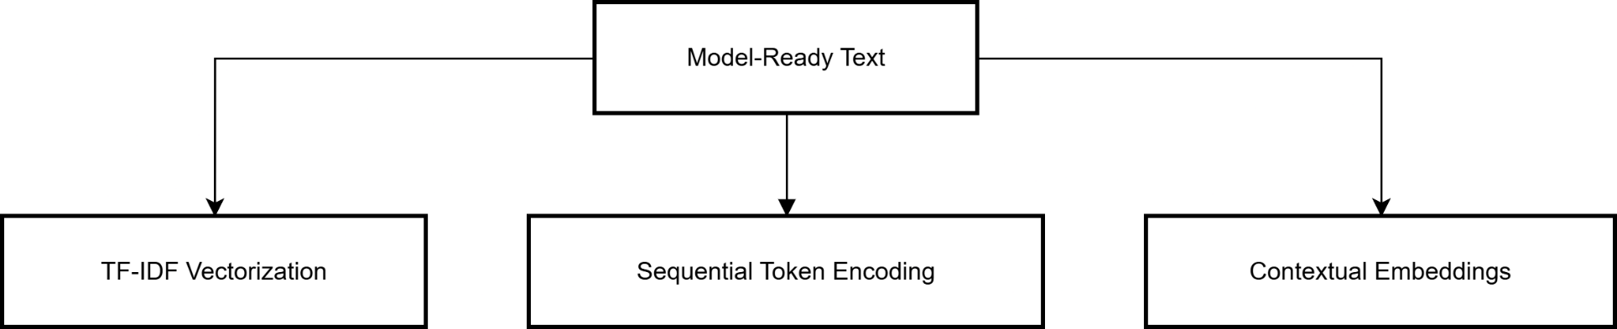
System Architecture for Social Media Health Monitoring
Fig: Feature Representation Layer
A Comparative Study of Mental Health Detection Using PHQ-9 and Social Media Analysis with Traditional ML and NLP Techniques
77

Slide 78

System Architecture for Social Media Health Monitoring
Fig: Base Model Layer
A Comparative Study of Mental Health Detection Using PHQ-9 and Social Media Analysis with Traditional ML and NLP Techniques
78

Slide 79

System Architecture for Social Media Health Monitoring
Fig: Stacked Ensemble Layer
A Comparative Study of Mental Health Detection Using PHQ-9 and Social Media Analysis with Traditional ML and NLP Techniques
79

Slide 80

System Architecture for Social Media Health Monitoring
Fig: Database Layer
A Comparative Study of Mental Health Detection Using PHQ-9 and Social Media Analysis with Traditional ML and NLP Techniques
80

Slide 81

System Architecture for Social Media Health Monitoring
Fig: Output & Response Layer
A Comparative Study of Mental Health Detection Using PHQ-9 and Social Media Analysis with Traditional ML and NLP Techniques
81

Slide 82
Dual Modality Depression Screening
A Comparative Study of Mental Health Detection Using PHQ-9 and Social Media Analysis with Traditional ML and NLP Techniques
82

Slide 83

Dual Modality Depression Screening
Fig: Passive Monitoring (Bengali Social Media NLP Pipeline)
A Comparative Study of Mental Health Detection Using PHQ-9 and Social Media Analysis with Traditional ML and NLP Techniques
83

Slide 84

Dual Modality Depression Screening
Fig: Active Clinical Assessment (PHQ-9 ML Pipeline)
A Comparative Study of Mental Health Detection Using PHQ-9 and Social Media Analysis with Traditional ML and NLP Techniques
84

Slide 85

Dual Modality Depression Screening
Fig: Explainable AI Layer
A Comparative Study of Mental Health Detection Using PHQ-9 and Social Media Analysis with Traditional ML and NLP Techniques
85

Slide 86

Dual Modality Depression Screening
Fig: Decision Integration Engine
A Comparative Study of Mental Health Detection Using PHQ-9 and Social Media Analysis with Traditional ML and NLP Techniques
86

Slide 87

Dual Modality Depression Screening
Fig: Clinical Workflow Management
A Comparative Study of Mental Health Detection Using PHQ-9 and Social Media Analysis with Traditional ML and NLP Techniques
87

Slide 88

Dual Modality Depression Screening
Fig: Continuous Monitoring Loop
A Comparative Study of Mental Health Detection Using PHQ-9 and Social Media Analysis with Traditional ML and NLP Techniques
88

Slide 89

Dual Modality Depression Screening
Fig: Clinical Outcomes Layer
A Comparative Study of Mental Health Detection Using PHQ-9 and Social Media Analysis with Traditional ML and NLP Techniques
89

